Slide 1
Pioneering Technologies
Together with our customers, we address the challenges of producing steel in an intelligent and sustainable way.
IIM DELHI | 2025

Slide 2
01
about
qoncept

Slide 3
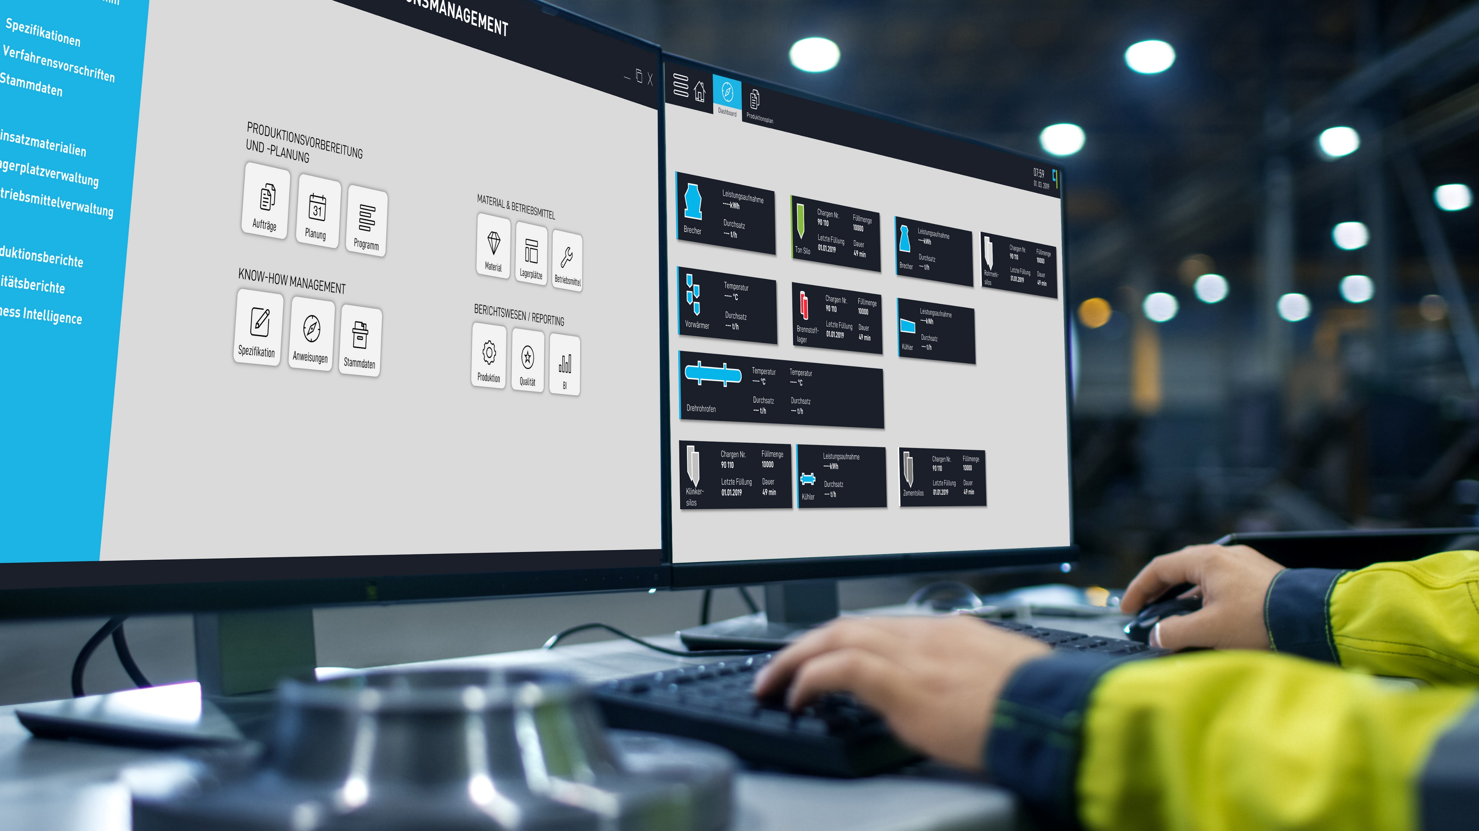














WE are living in a different era
Mechanical Production
Mass Production
Automated
Production
Intelligent, flexible and distributed Production
18th Century
19th Century
Mid 20th Century
Today
Traceability
SMART SENSORS
Steam Power
Electricity
Computer
Artificial Intelligence
Today
ADVANCED ROBOTICS
ADVANCED ANALYTICS
COMPUTING AND SIMULATION
Notes:
Today we are living in different era of intelligent, flexible and distributed production

Slide 4









OUR Mission
We digitize and transform metallurgical processes into software that creates added value.
Notes:
We digitize and transform metallurgical processes in software that creates added valve

Slide 5
Our Product Portfolio
Software Solutions for Steelmaking
Modular and customer-centric solutions
Metallurgical Consulting
Technology Transfer, Fact Finding, Process Optimization
Consulting towards Digital Innovation
Analyzing the as-is situation and development of roadmaps
Notes:
Read from screen

Slide 6
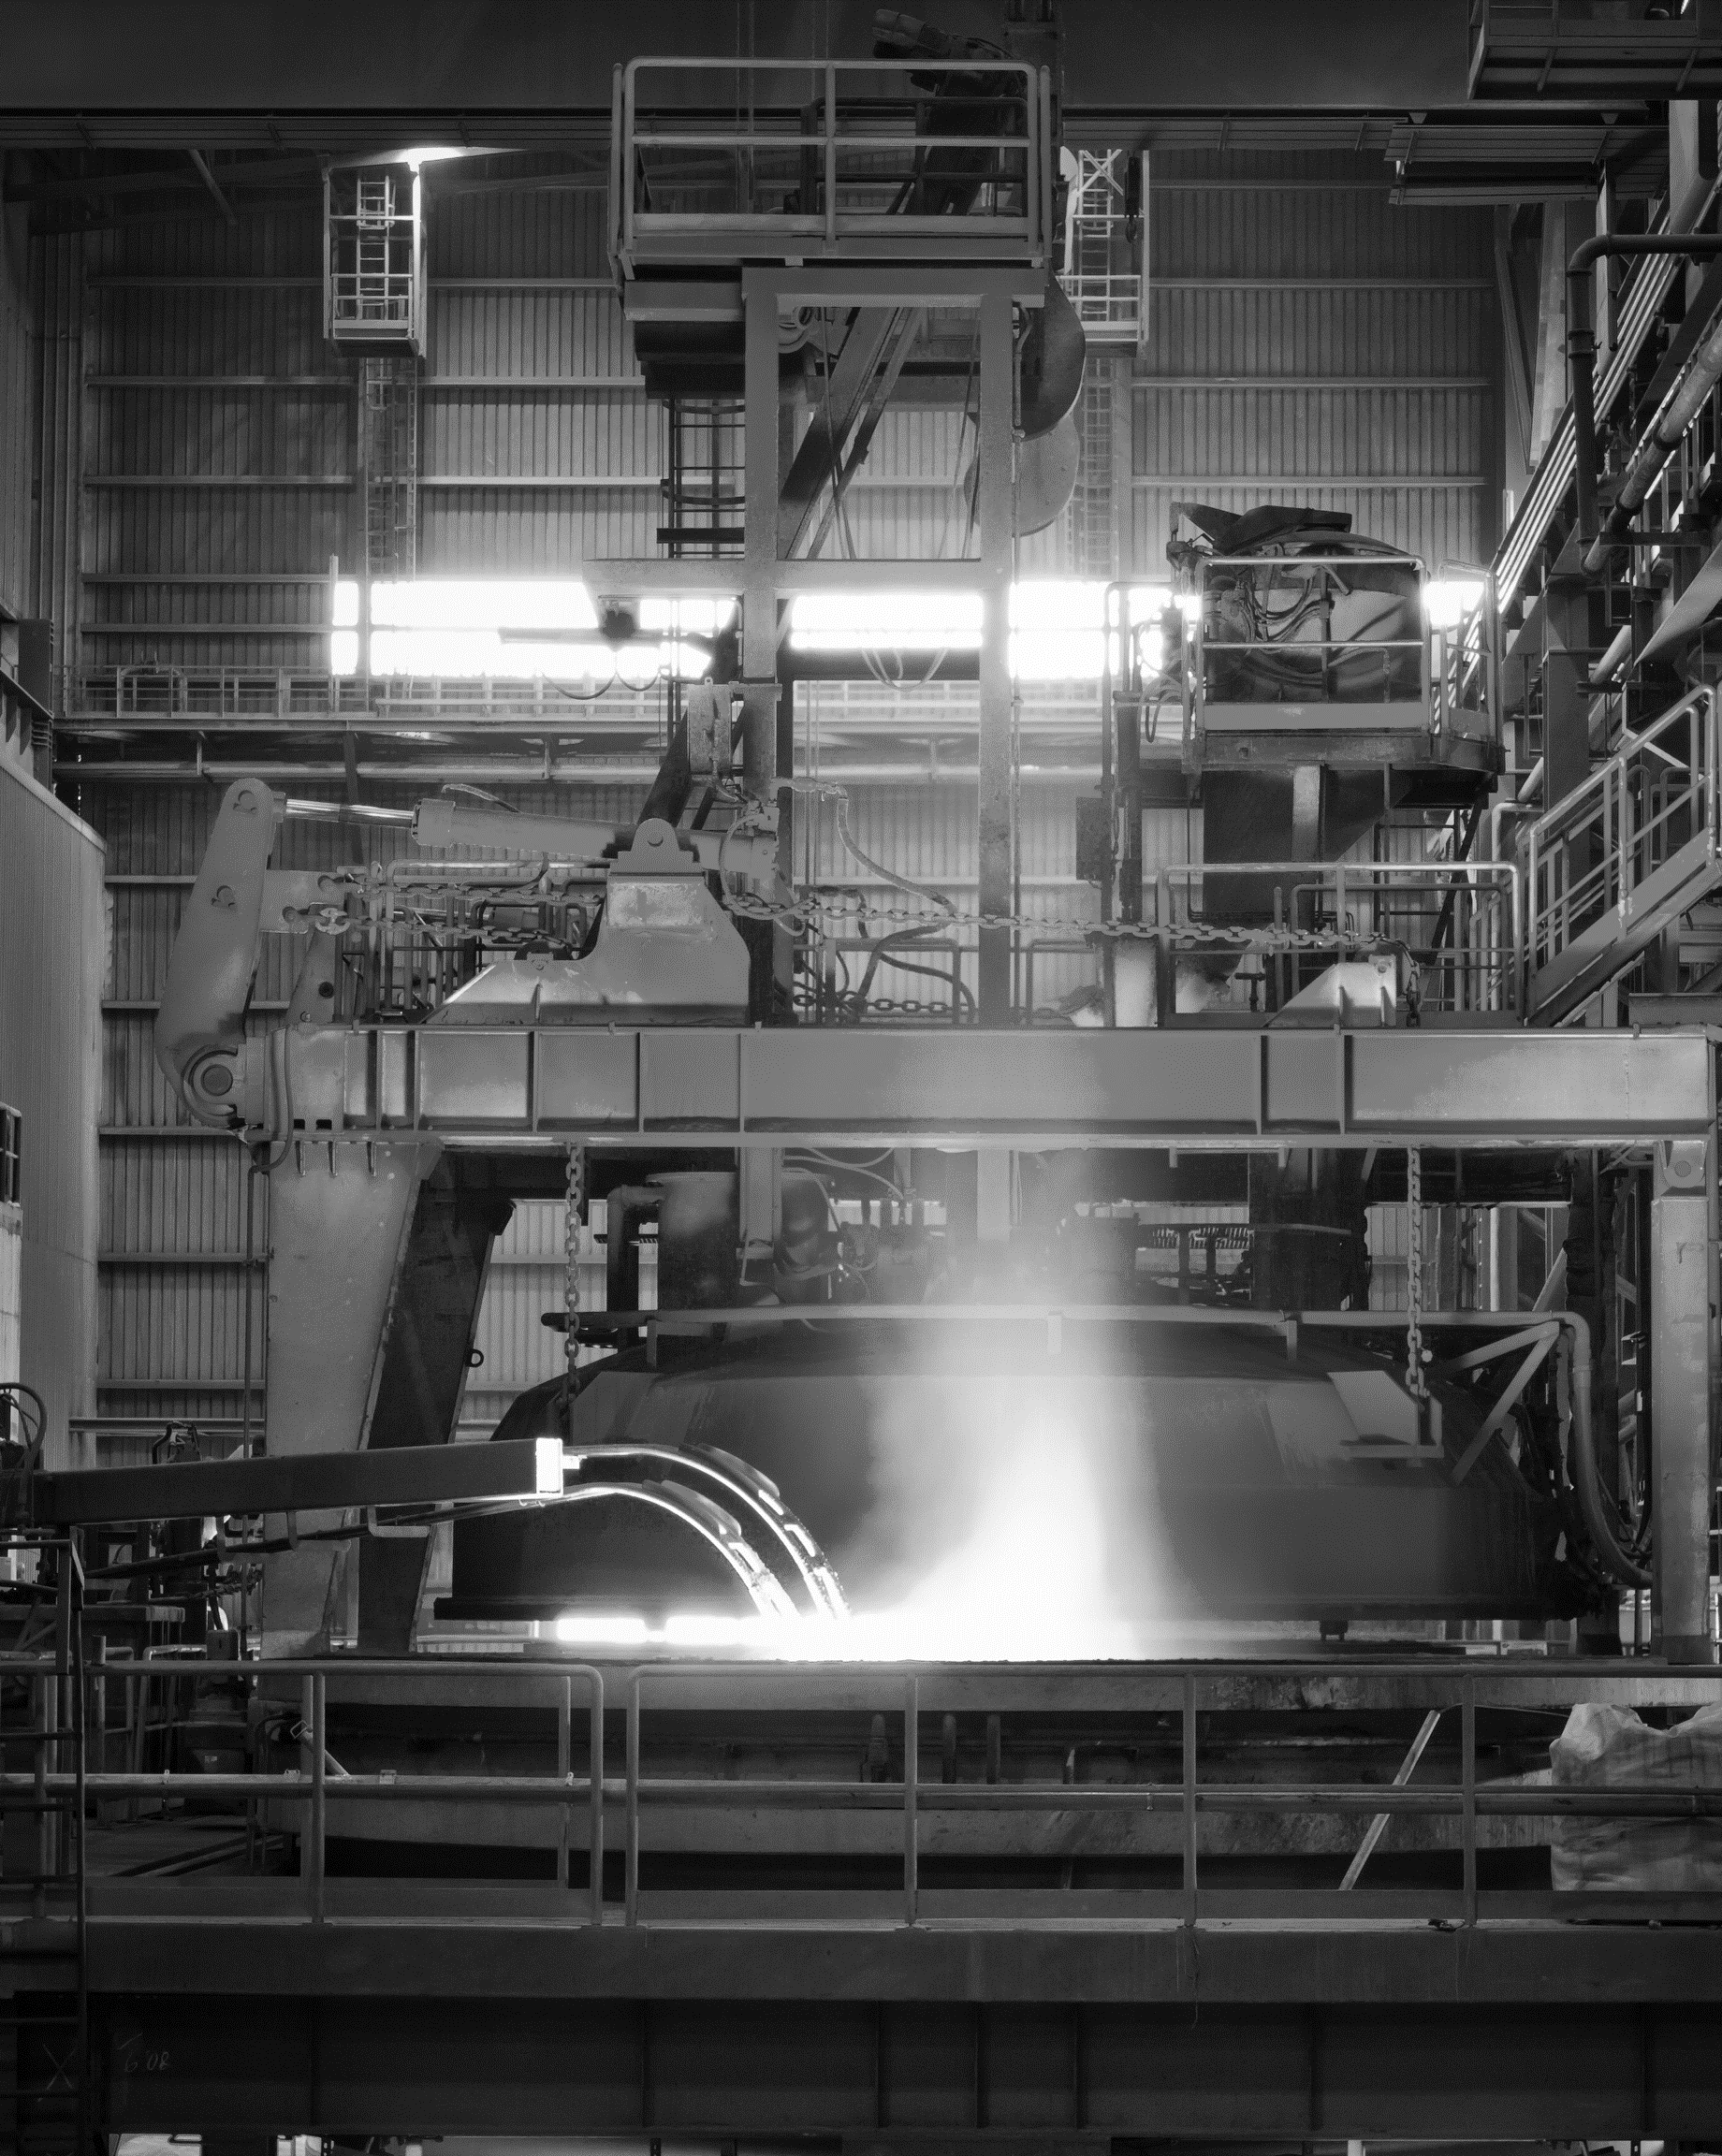
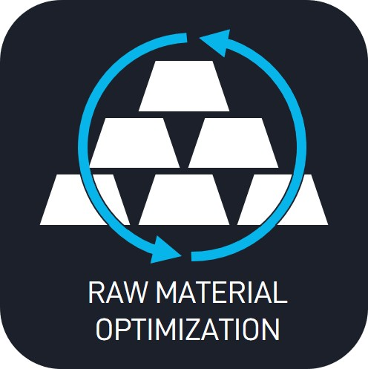


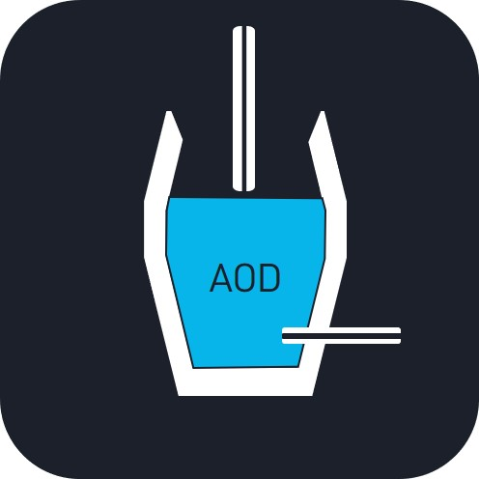
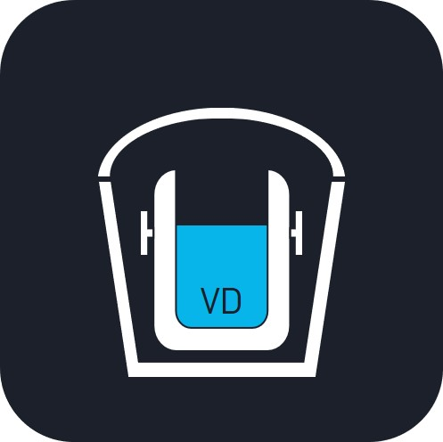
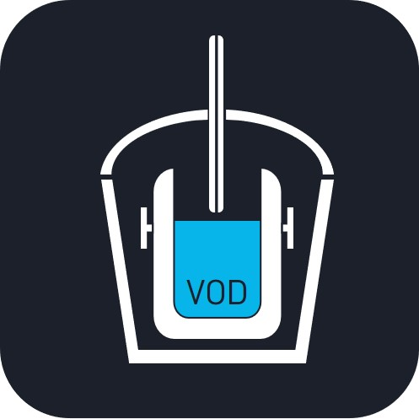
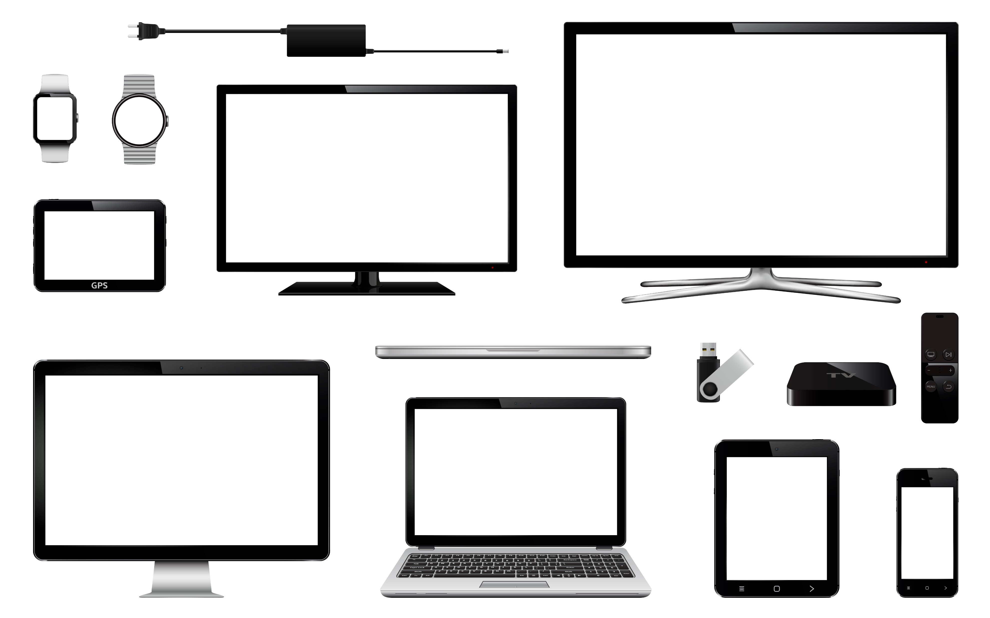
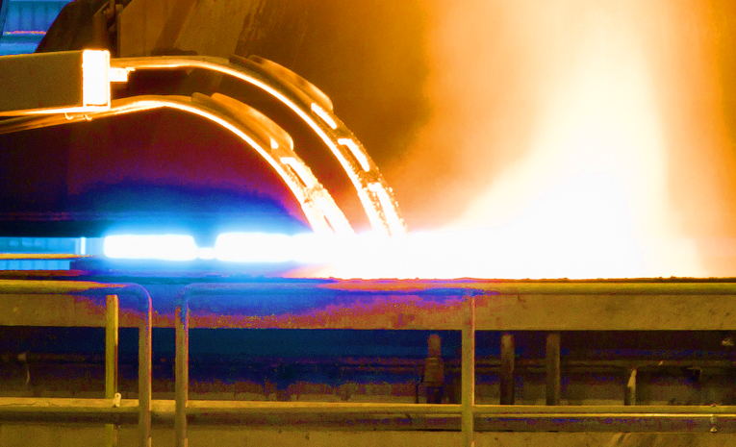
Real-time and off-line metallurgical models for process supervision, control and optimization
Software Solutions
Computational Metallurgy
Benefits:
Optimize Material Input
Reduce Energy Consumption
Reduce Treatment Time
Ensure Steel Quality
Notes:
Computational Metallurgy software have beefits like :
Optimization of material cost
Reduced energy consumption
Ensure quality
Reduce treatment time
Reduce rejections

Slide 7
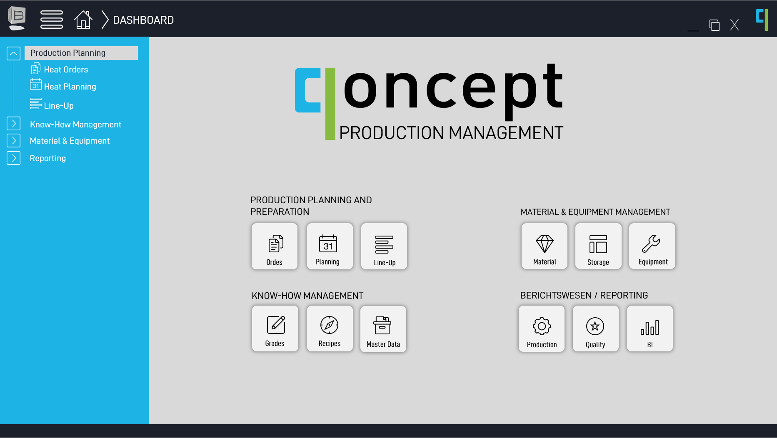

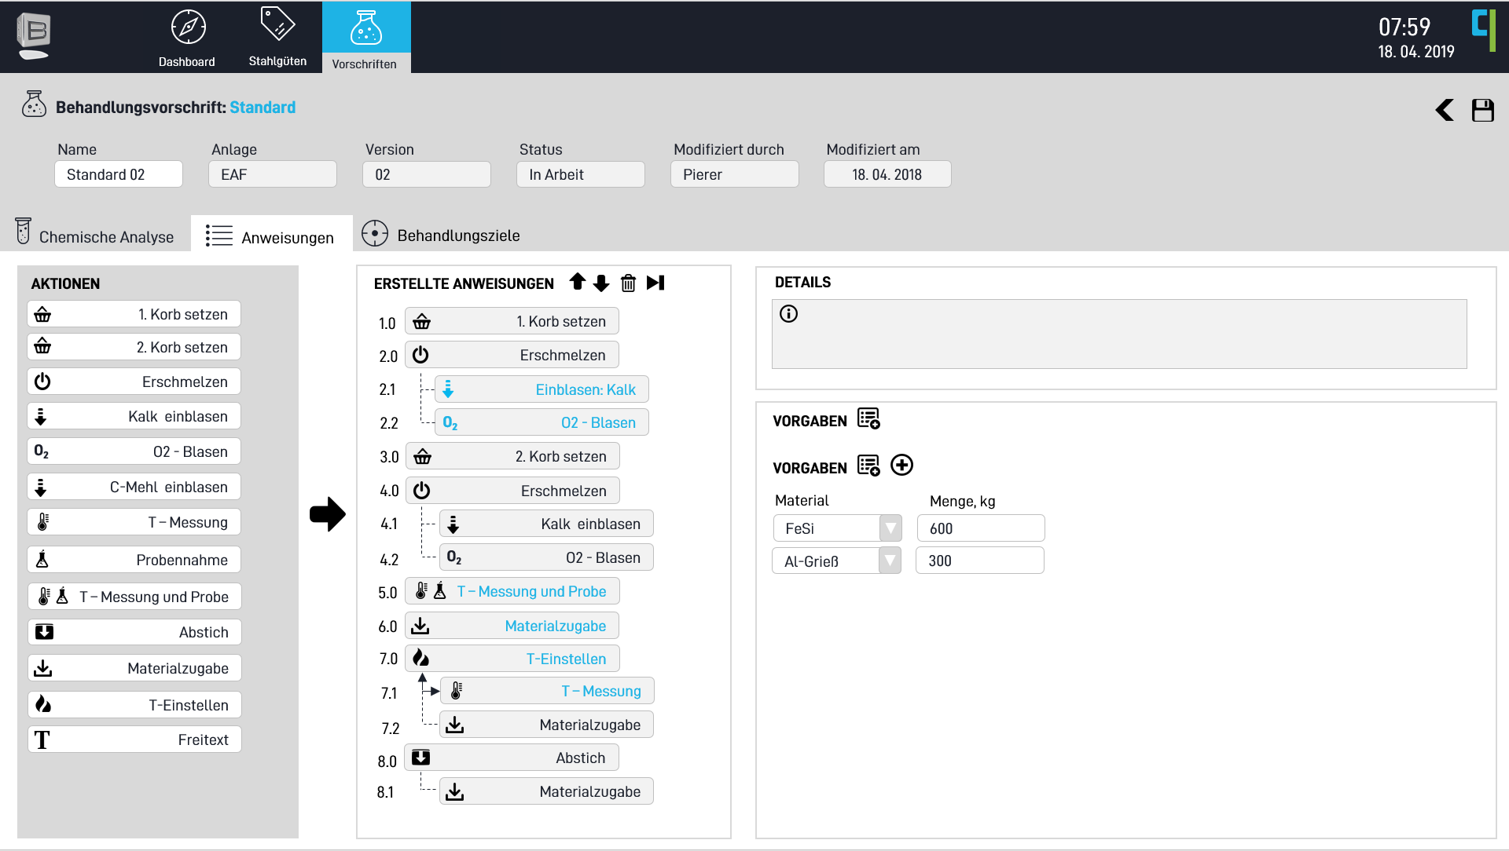
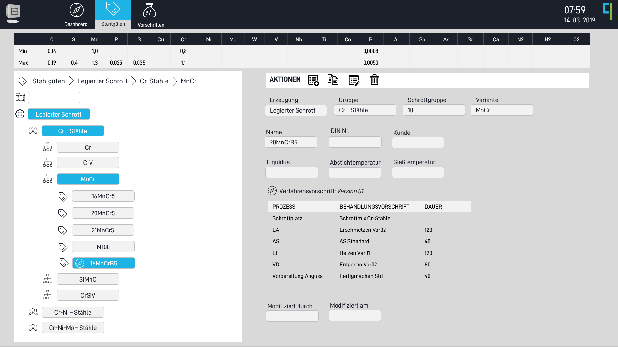

Software Solutions
Comprehensive Software Solutions:
Treatment Recipe Management
Notes:
This slide gives screen hot of typical treatment recipe for steel making

Slide 8
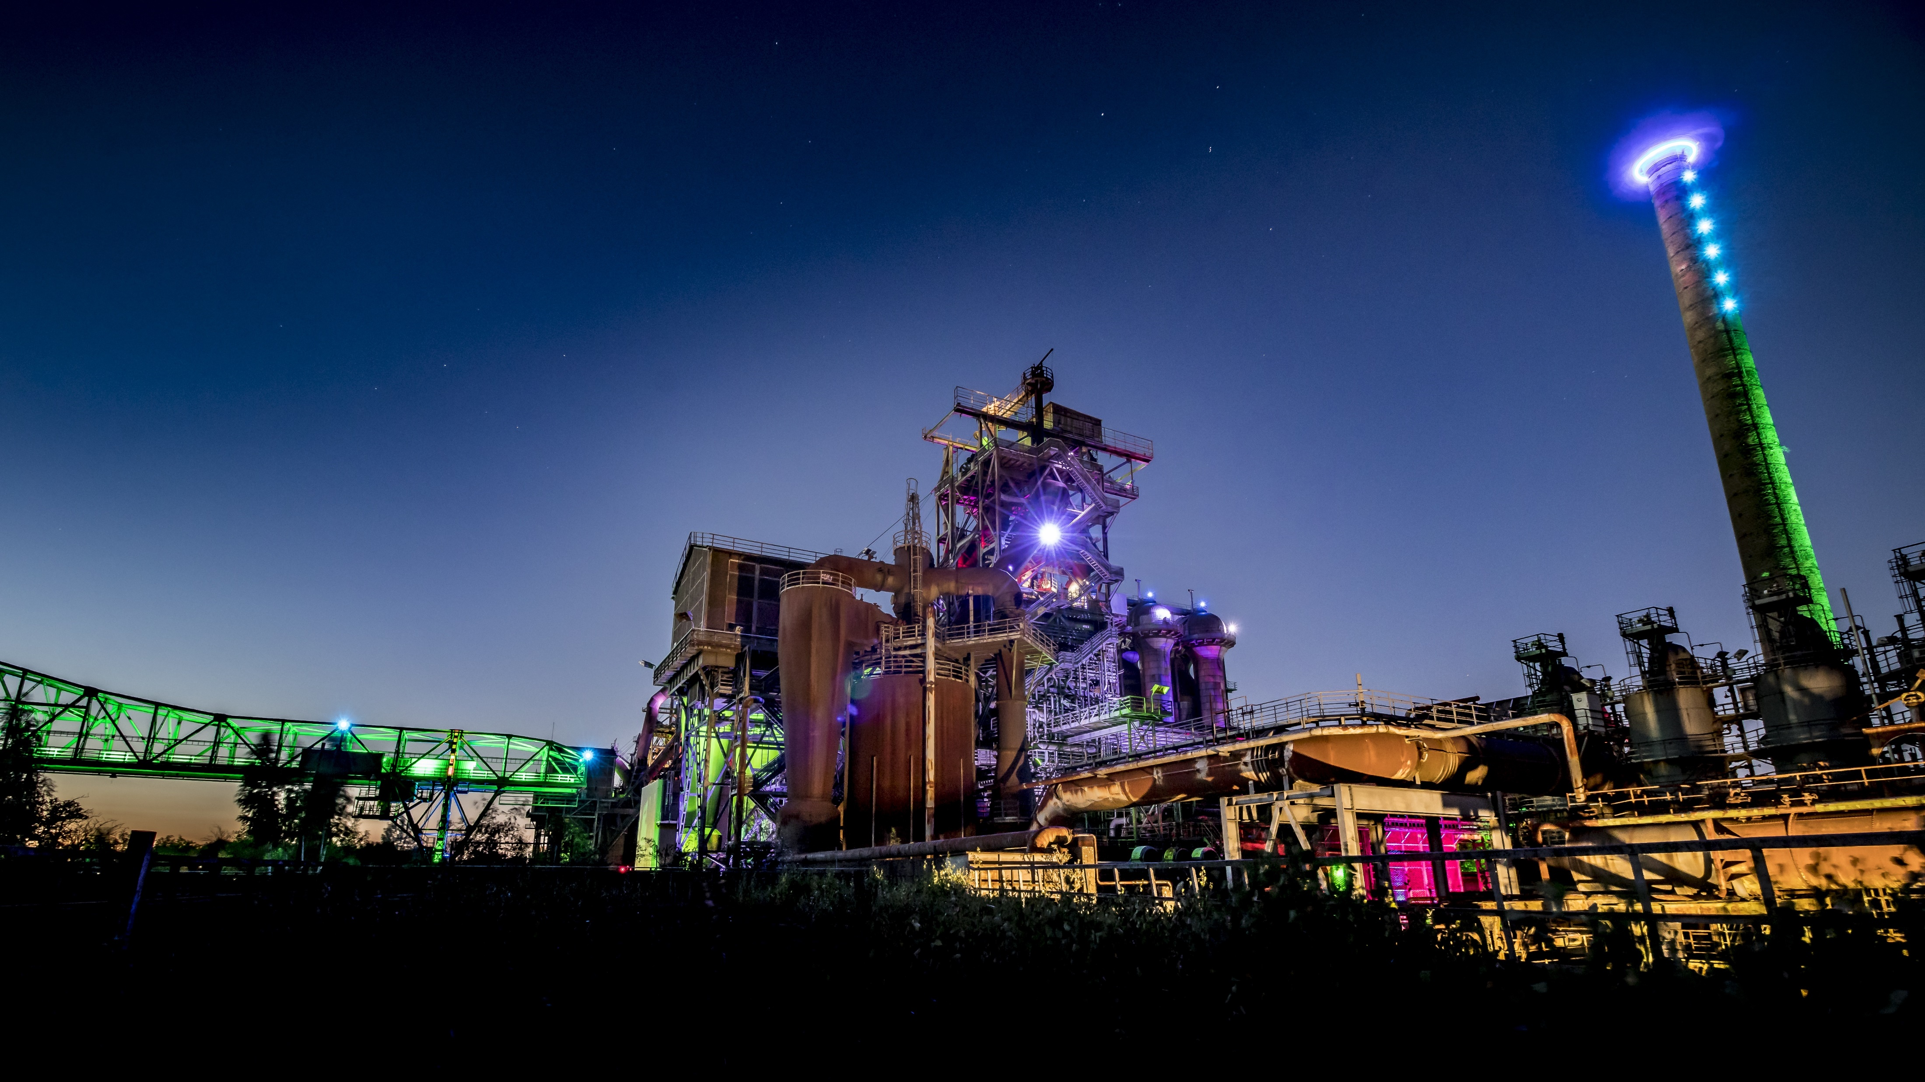




What we do
qoncept provides you with pioneering technologies to enable intelligent steelmaking processes.
We understand intelligent production to be
sustainable
safe
efficient
optimized

Slide 9

Who we are
Bringing together different competences, thinking across boundaries and acting as systems engineers.
System Engineers | Innovators
Mechanical Engineers
Software Developers | Mathematicians
Metallurgists | Physicists

Slide 10
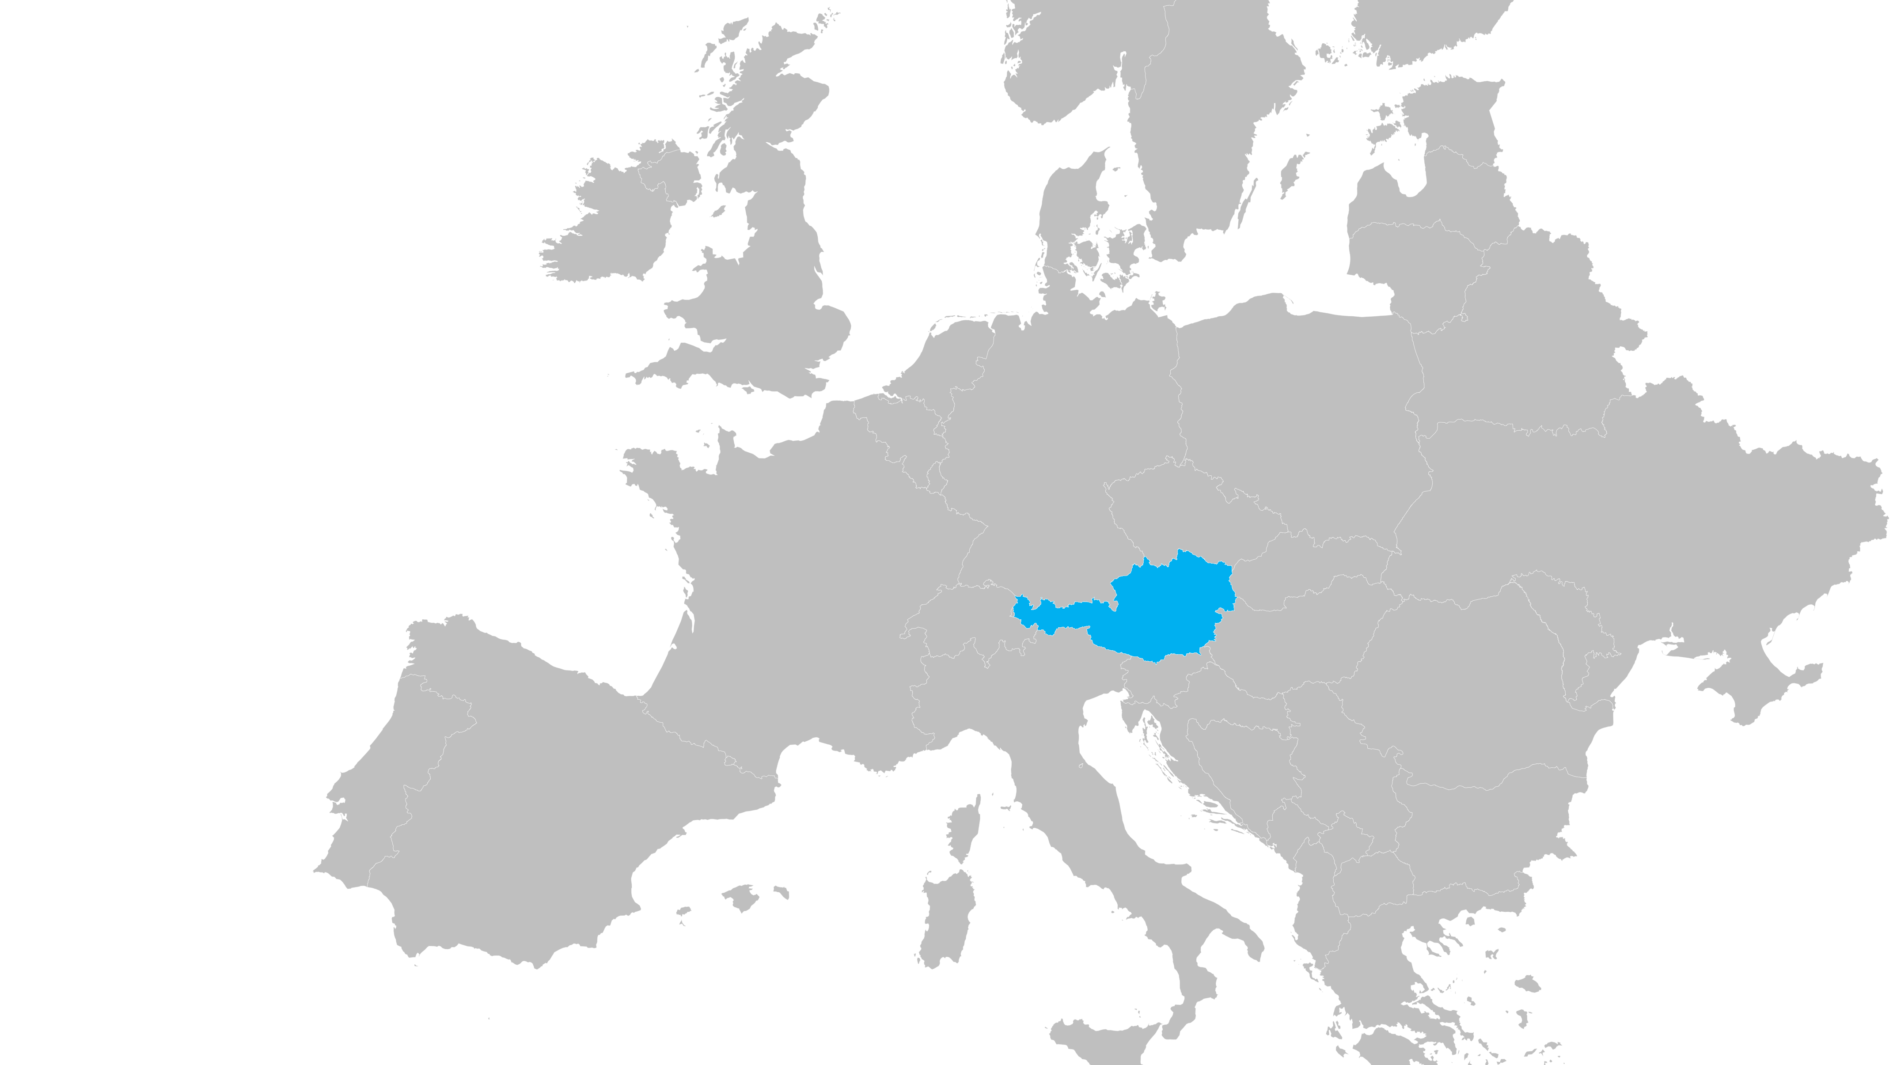

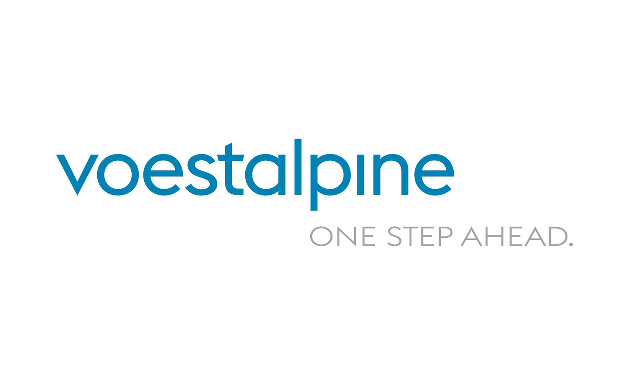




Where we are
Austria
Leoben

Slide 11

where we have worked
austrian roots and global reach

Slide 12
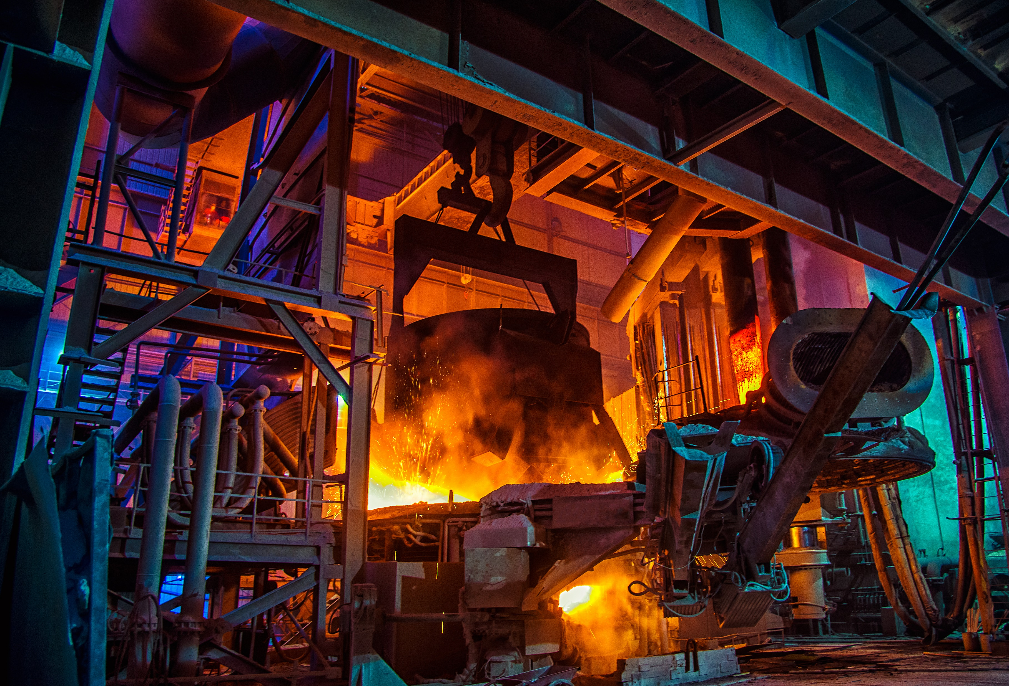
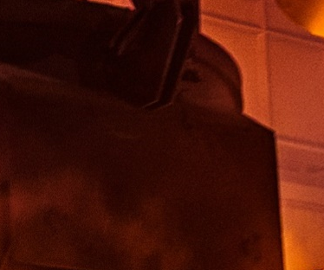

What we Offer
Software & Hardware
Raw Material Management
Digital Metallurgical Twins
Level 2 Software
Manufacturing Execution System
Ladle Management
Intelligent Cameras
Operating Terminals
Equipment & Devices
Automatic Gas Coupler
Heavy Duty Multiline Coupler
Automatic Slide-Gate Coupler
Bins and Silos
Consulting & Studies
Metallurgical Process Optimization
Requirement & Software Engineering
Feasibility & Business Strategy Studies

Slide 13
02
software and hardware

Slide 14
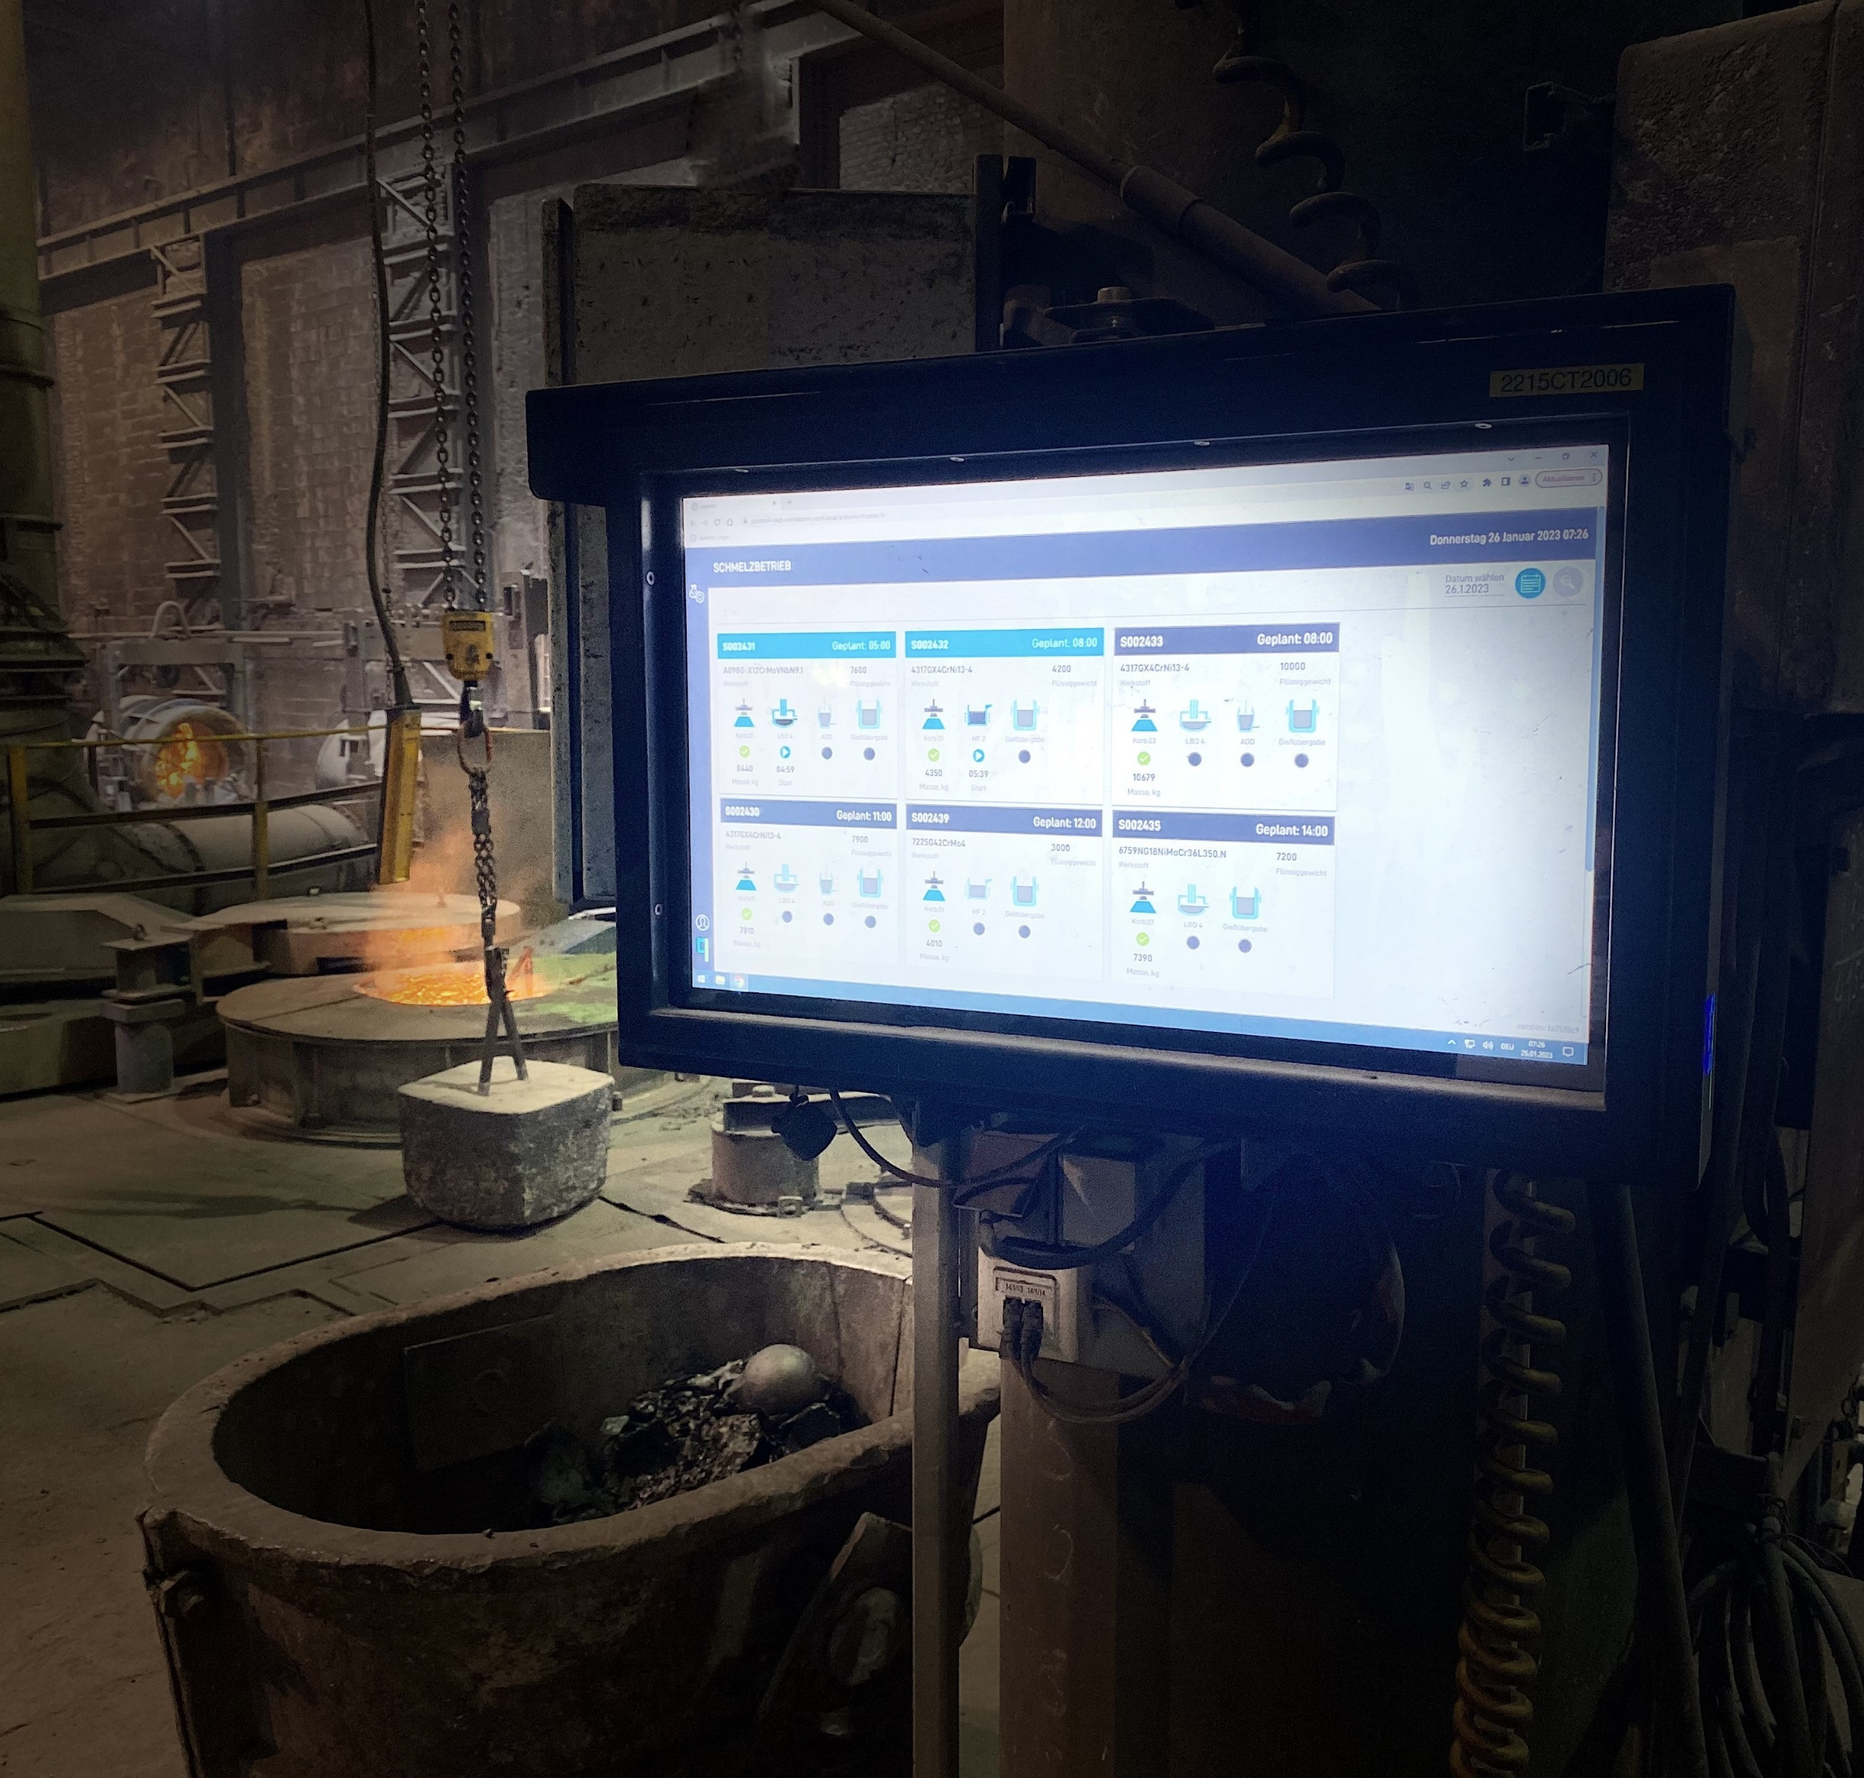
Software and Hardware
portfolio (Solutions)
Make steel production as efficient as possible through the transformation of (metallurgical) processes into customer-centric software.
Raw Material Management
Digital Metallurgical Twins
Level 2 Software
Manufacturing Execution System
Ladle Management
Intelligent Cameras
Operating Terminals
Software
Hardware

Slide 15

Process Models – Level 2
What do we do differently?
π
Equipment Configuration
Model Parameter Library
Preprocessing
Postprocessing
PRIMARY METALLURGY
EAF
BOF
Heat Transfer Model
HEATING AND REFINING
LF
Mass Transfer Model
Computational Kinetics
Computational Thermodynamics
DEGASING (VD and RH)
VD
RH
EAF-Specific Submodels
LF-Specific Submodels
VD-Specific Submodels
AOD-Specific Submodels
DECARBURIZATION
AOD
VOD
Data Processing Manager

Slide 16
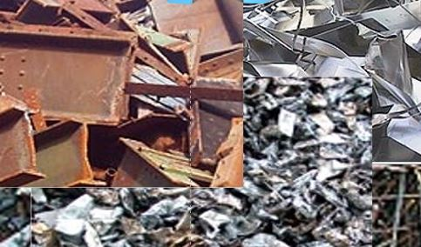
Software Solutions
Computational Metallurgy
Raw Material Optimization (RMO)
RMO software application offers the opportunity to determine the demand for raw materials for the planned material mix of a production period.
Notes:
Depending on the alloy content of the grade to be produced, the share of raw material costs (scrap, alloying materials and metals) can be up to 60% of the total production costs . In order to minimize raw material costs and to avoid deviations from analyses, the RMO software application offers the opportunity to determine the demand for raw materials for the planned material mix of a production period.

Slide 17
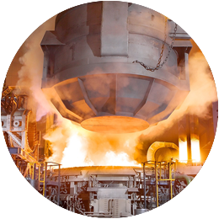

Software Solutions
Electric Arc Furnace (EAF)
- The off-line model :
- The on-line model :
Notes:
The off-line model calculates the melting of the scrap (fraction of solid and liquid), the melt temperature as well as the chemical composition of melt and slag based on a definable melting pattern and the charged scrap type and mass. The on-line model calculates the parameters mentioned above based on real data recorded during the process.

Slide 18
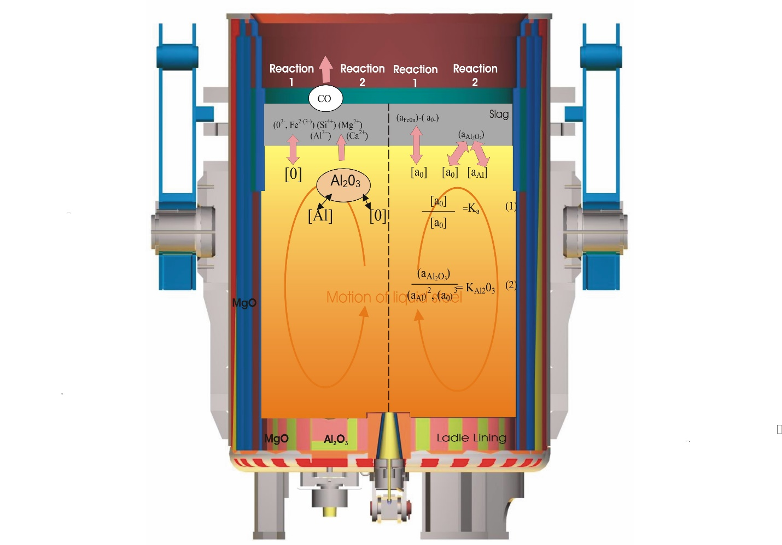
Software Solutions
Ladle Furnace (LF)
The off-line model
The On-Line model
Notes:
The off- and on-line application for the LF calculate the heat gain due to heating (arcing), the heat losses through the refractory lining and the surface (radiation), heat losses by inert gas stirring as well as temperature changes by material addition. The thermochemical and thermodynamic models (particularly desulphurization and deoxidation) account for the composition changes of slag and melt.

Slide 19

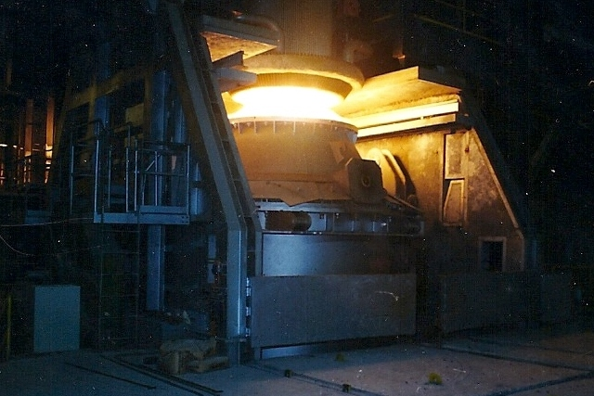
Software Solutions
Argon Oxygen Decarburization (AOD)
(1) calculation of the optimal blowing pattern (semi-dynamic)
(2) dynamic calculation of the current state of the melt, slag and temperature.
Notes:
1) calculation of the optimal blowing pattern (semi-dynamic)
(2) dynamic calculation of the current state of the melt, slag and temperature. For this purpose, the approach of the holistic model combines the heat balance model, the thermochemical and the thermodynamic model, the decarburization model (kinetic approach) and the models for the calculation of reduction materials and slag formers

Slide 20
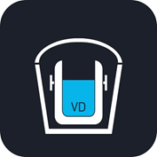
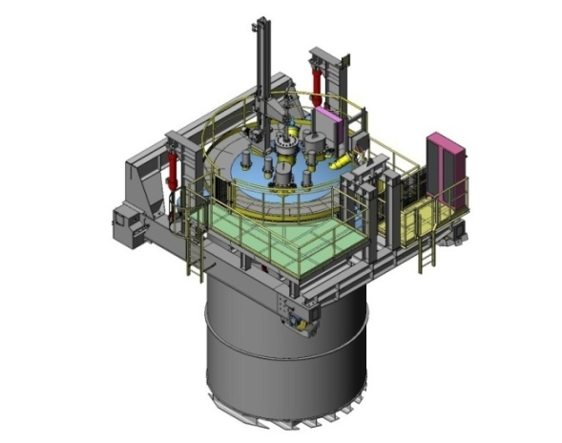
Software Solutions
Vacuum Degassing (VD)
The computational metallurgy application for vacuum degassing (off- and on-line)
Notes:
The computational metallurgy application for vacuum degassing (off- and on-line) incorporates the heat balance model (including the additional heat change due to decreased pressure) as well as the thermochemical and thermodynamic models, i.e., the kinetic models of degassing of hydrogen and nitrogen.

Slide 21

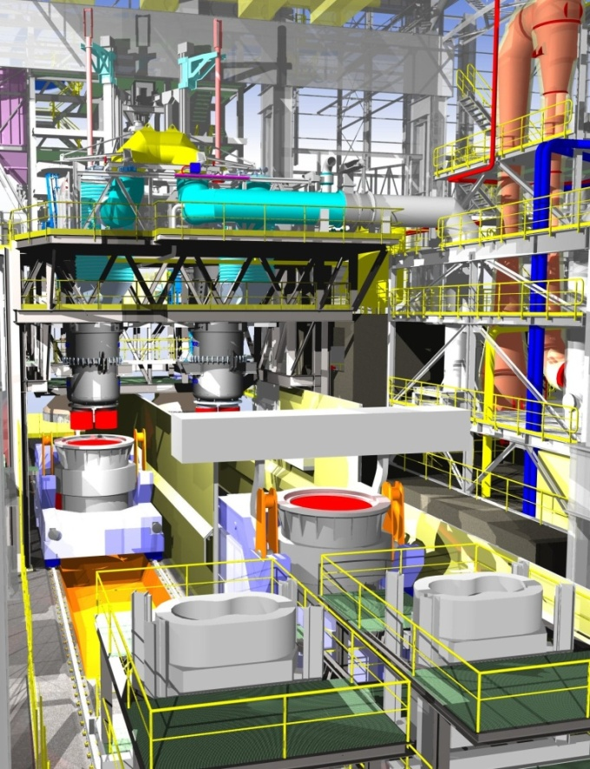
Software Solutions
Vacuum Oxygen Decarburization (VOD)
Basically, the VOD model is similar to the AOD model as both processes are based on lowering the partial pressure of CO.
Notes:
Basically, the VOD model is similar to the AOD model as both processes are based on lowering the partial pressure of CO. A semi-dynamic approach calculates the optimal blowing pattern and the various chemical and physical sub-models calculate the current condition of the melt throughout the VOD process.

Slide 22
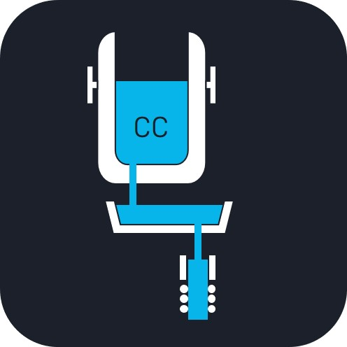
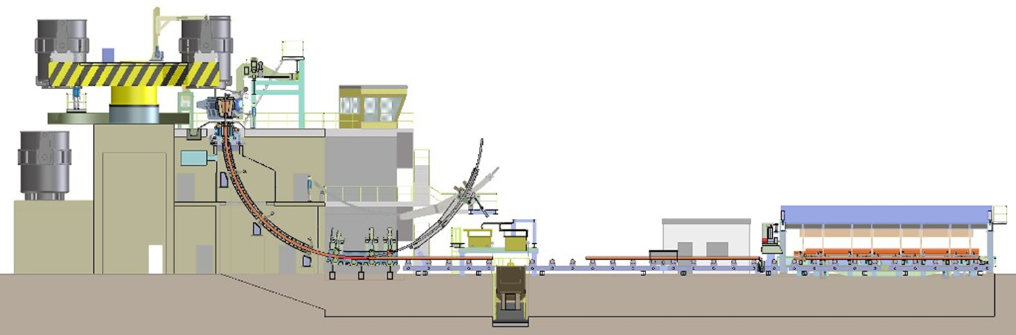
Software Solutions
Computational Metallurgy
Computational Casting
qoncept makes use of numerical algorithms and models to compute the thermo-physical fundamentals which occur during the continuous casting process.
Notes:
A comprehensive analysis of the dedicated states in the continuous casting process from a technologically oriented, metallurgical approach is essential for the following metallurgical interpretations:
Understanding of the temperature distribution on the strand surface and selected positions inside the cast strand.
Understanding of the shell growth for selected fractions of solid during the whole casting process.
Determination of point of total solidification.
Determination of optimal positioning of technological devices such as
- Strand electro-magnetic stirrers
- Final electro-magnetic stirrers
- Mechanical or thermal soft-reduction
- Soft-cooling tunnels

Slide 23
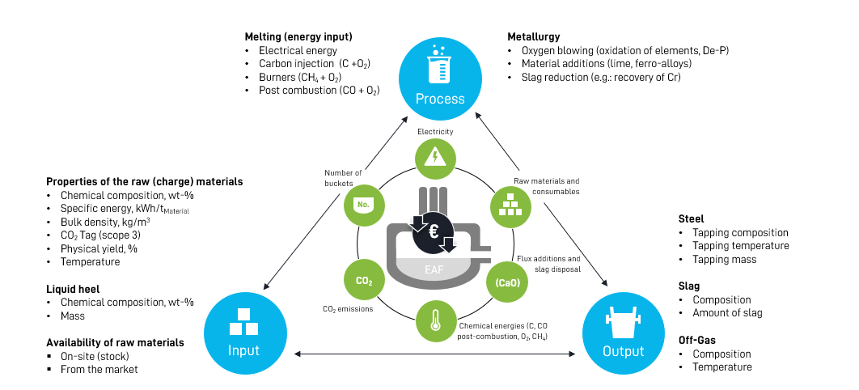
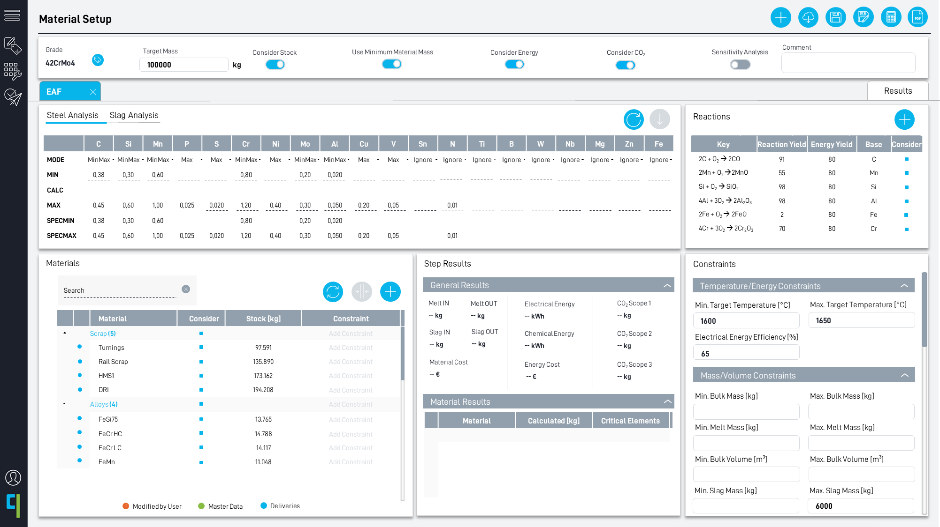
Software
References – Raw material Management
Raw material characterization and optimization at an Italian rebar producer.

Slide 24
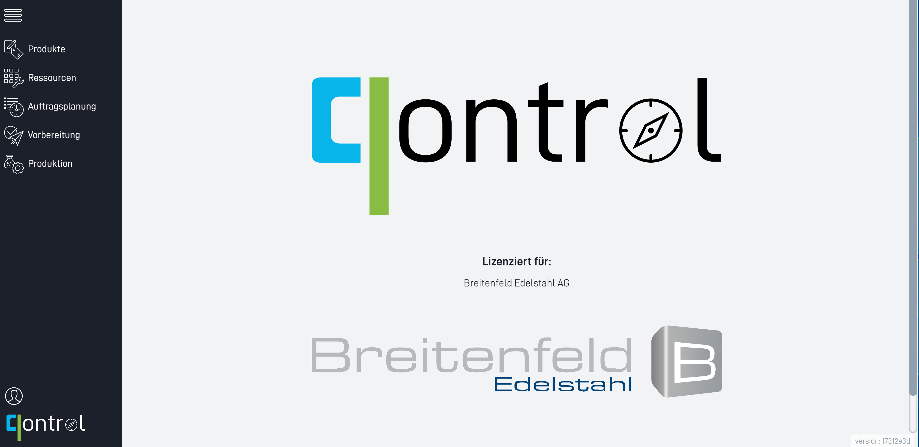
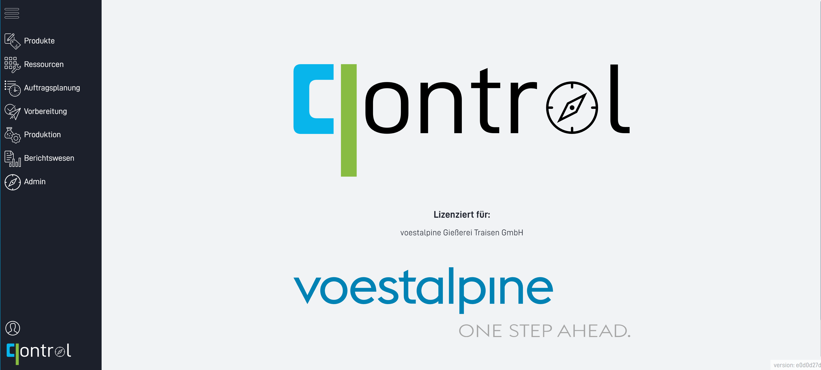
Software
References – Level 2 and Level 3 Software
Level 2/3 software implementation for a foundry operating EAF, IF and AOD
Level 2/3 software implementation for stainless steelmaking (SY – EAF – LF – VD/VOD – IC)

Slide 25
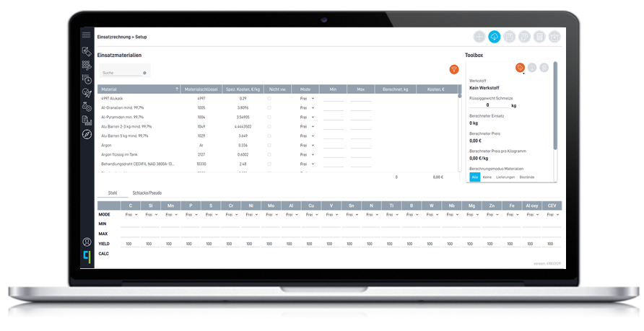
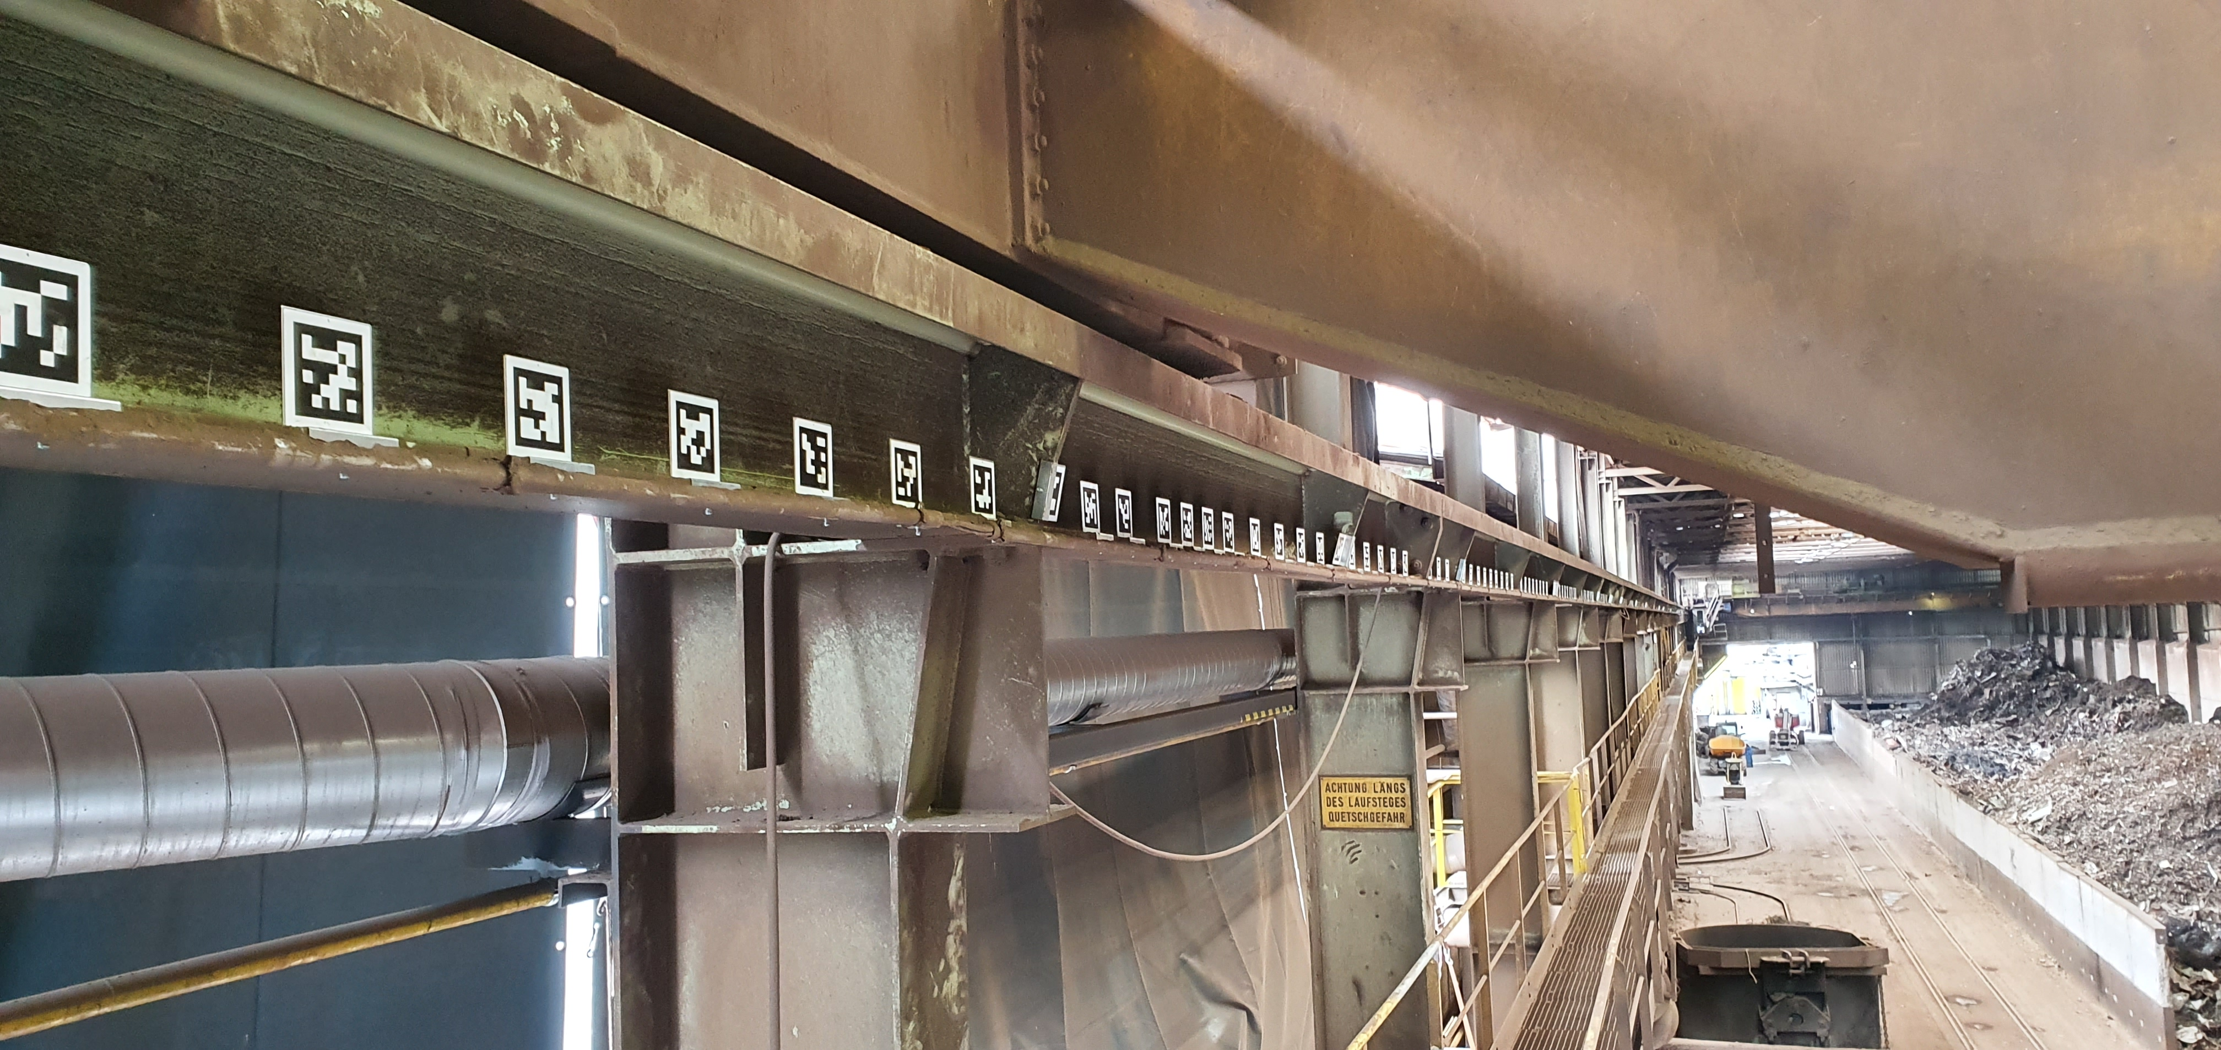
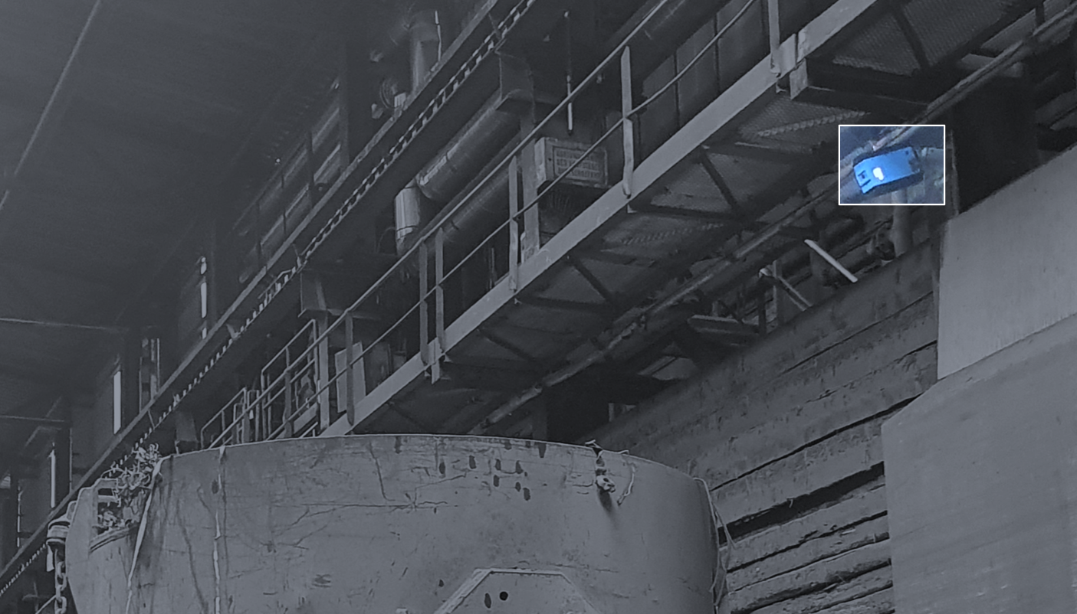
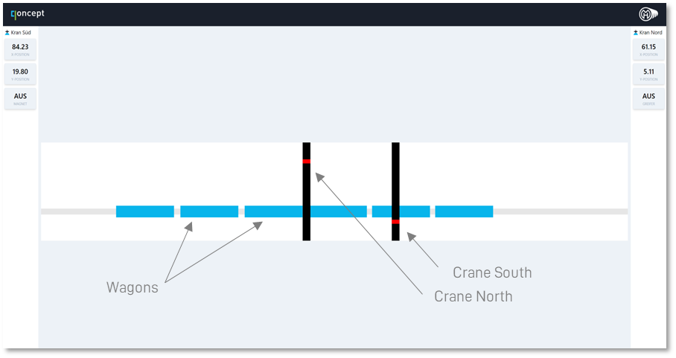

Software
References – Scrap Yard Software
Automatic tracking of all material movements with the scrap yard of a rebar producer

Slide 26

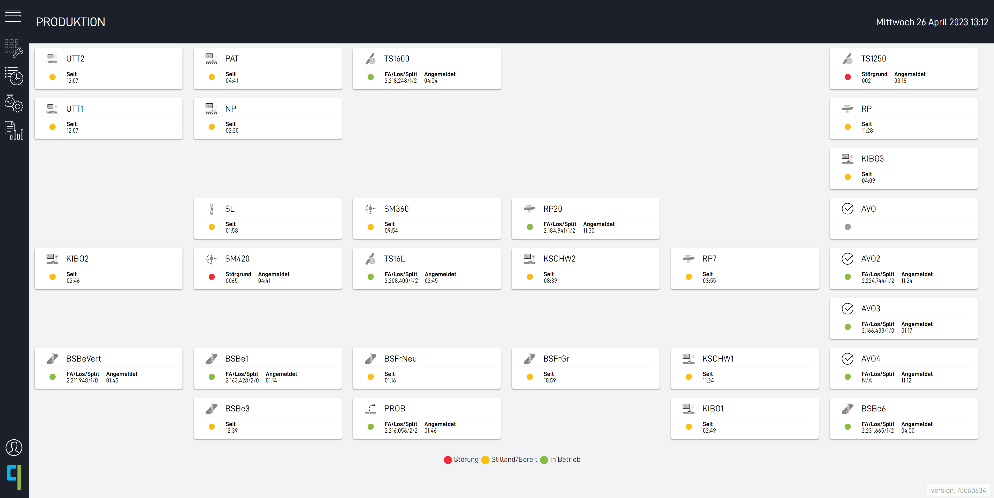

Software
References – Finishing Line
Complete replacement of paper-based production management by our qontrol software

Slide 27
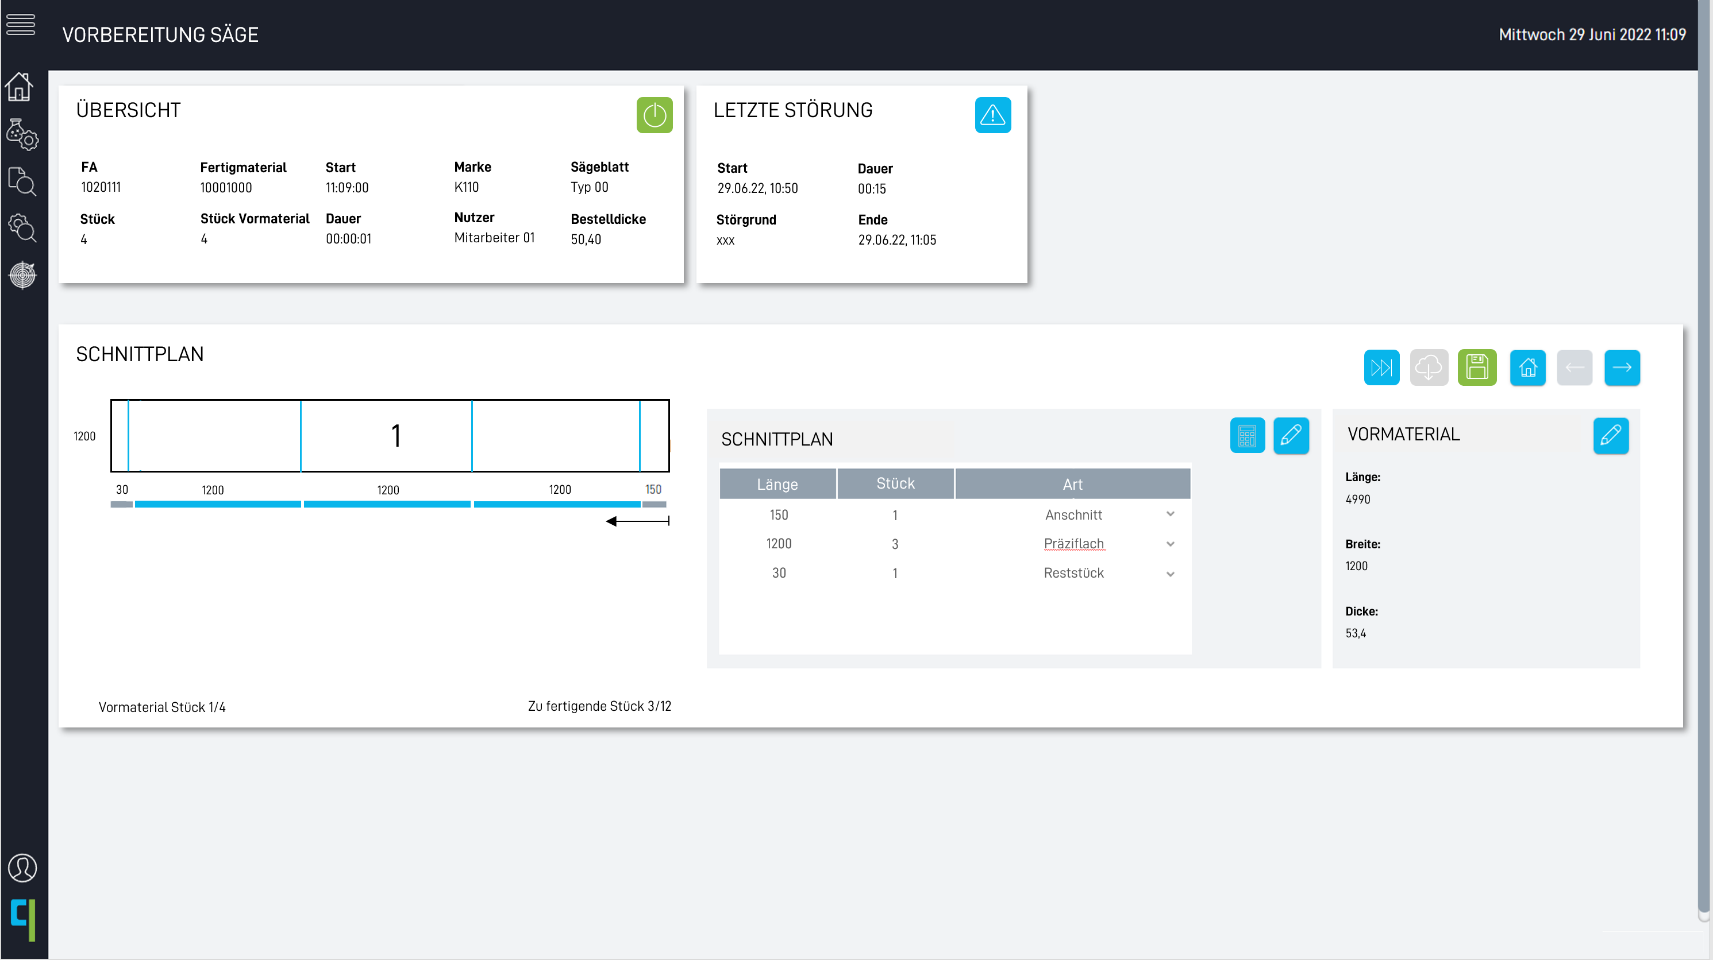
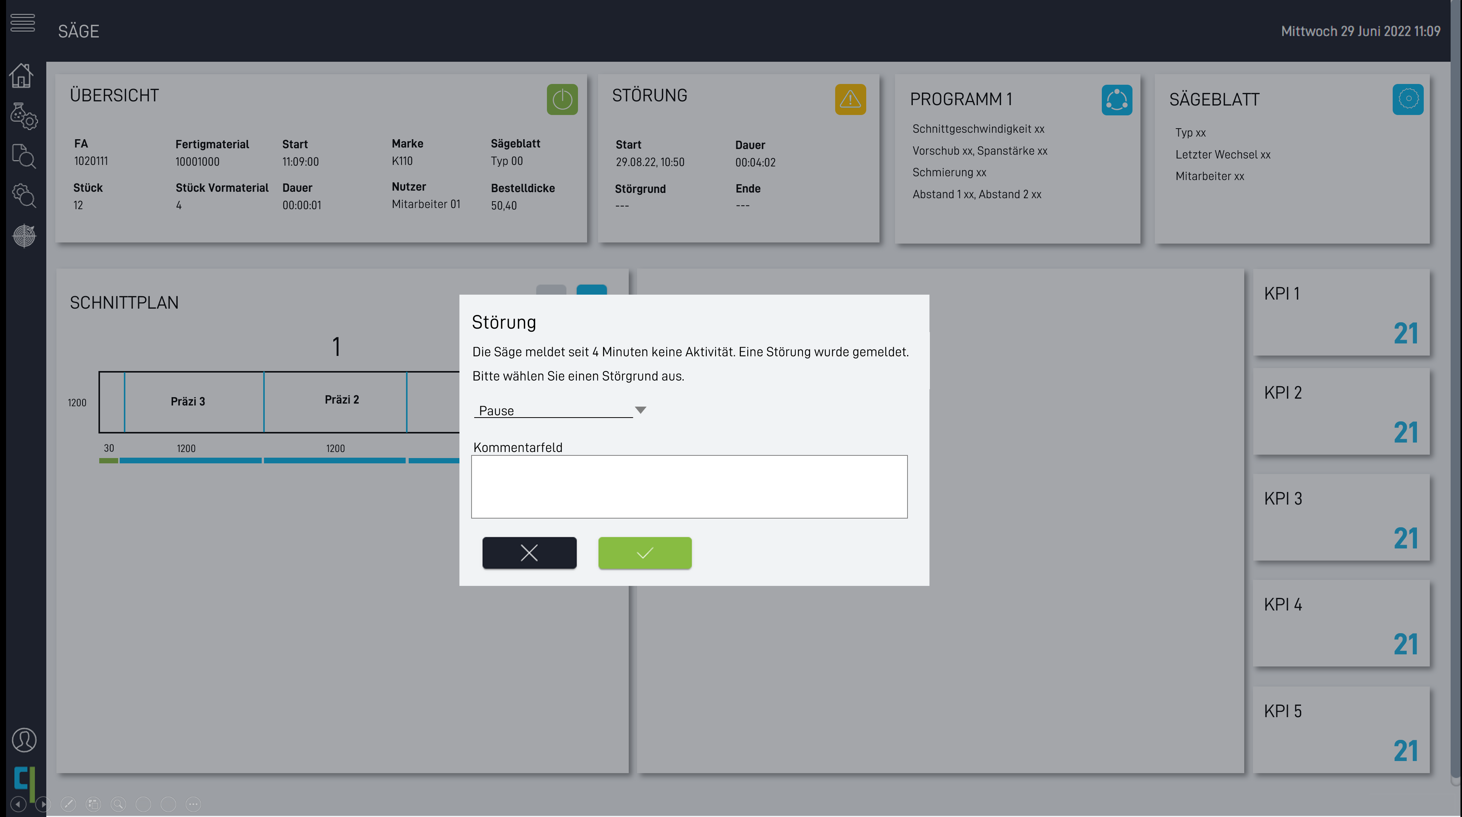
Software
References – Flat Rolled Steel
Software to support the processing of flat rolled steel

Slide 28
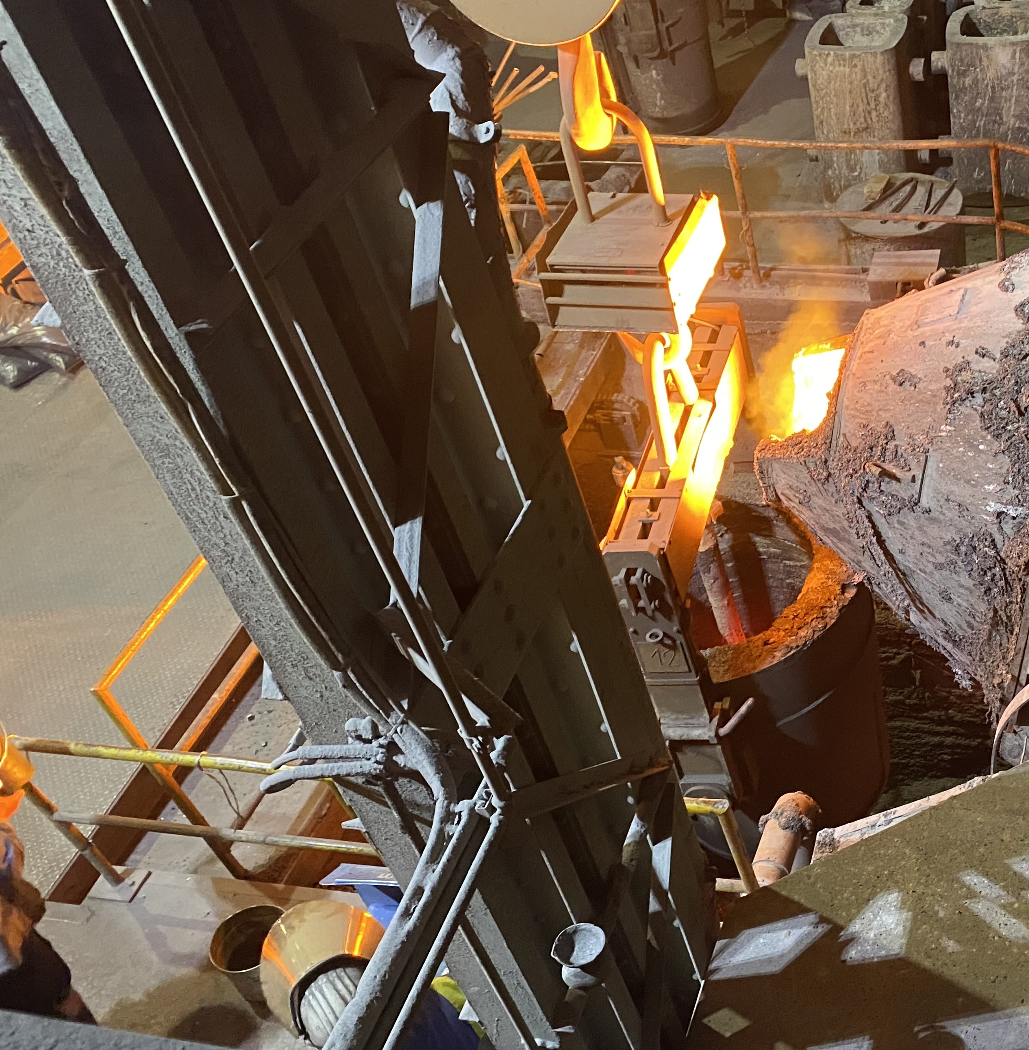


Testimonial
Digitalization | Industrial Software
Digitalization of a Foundry’s Melt Shop
With qoncept's software, we have finally found a solution that makes our daily work in the melting shop much easier. Thanks to the integration of our own experience into the software, the intuitive usability and the automated processes, we can now fully concentrate on our core tasks.
Johannes Ladinger
Chief Process Manager - Casting

Slide 29
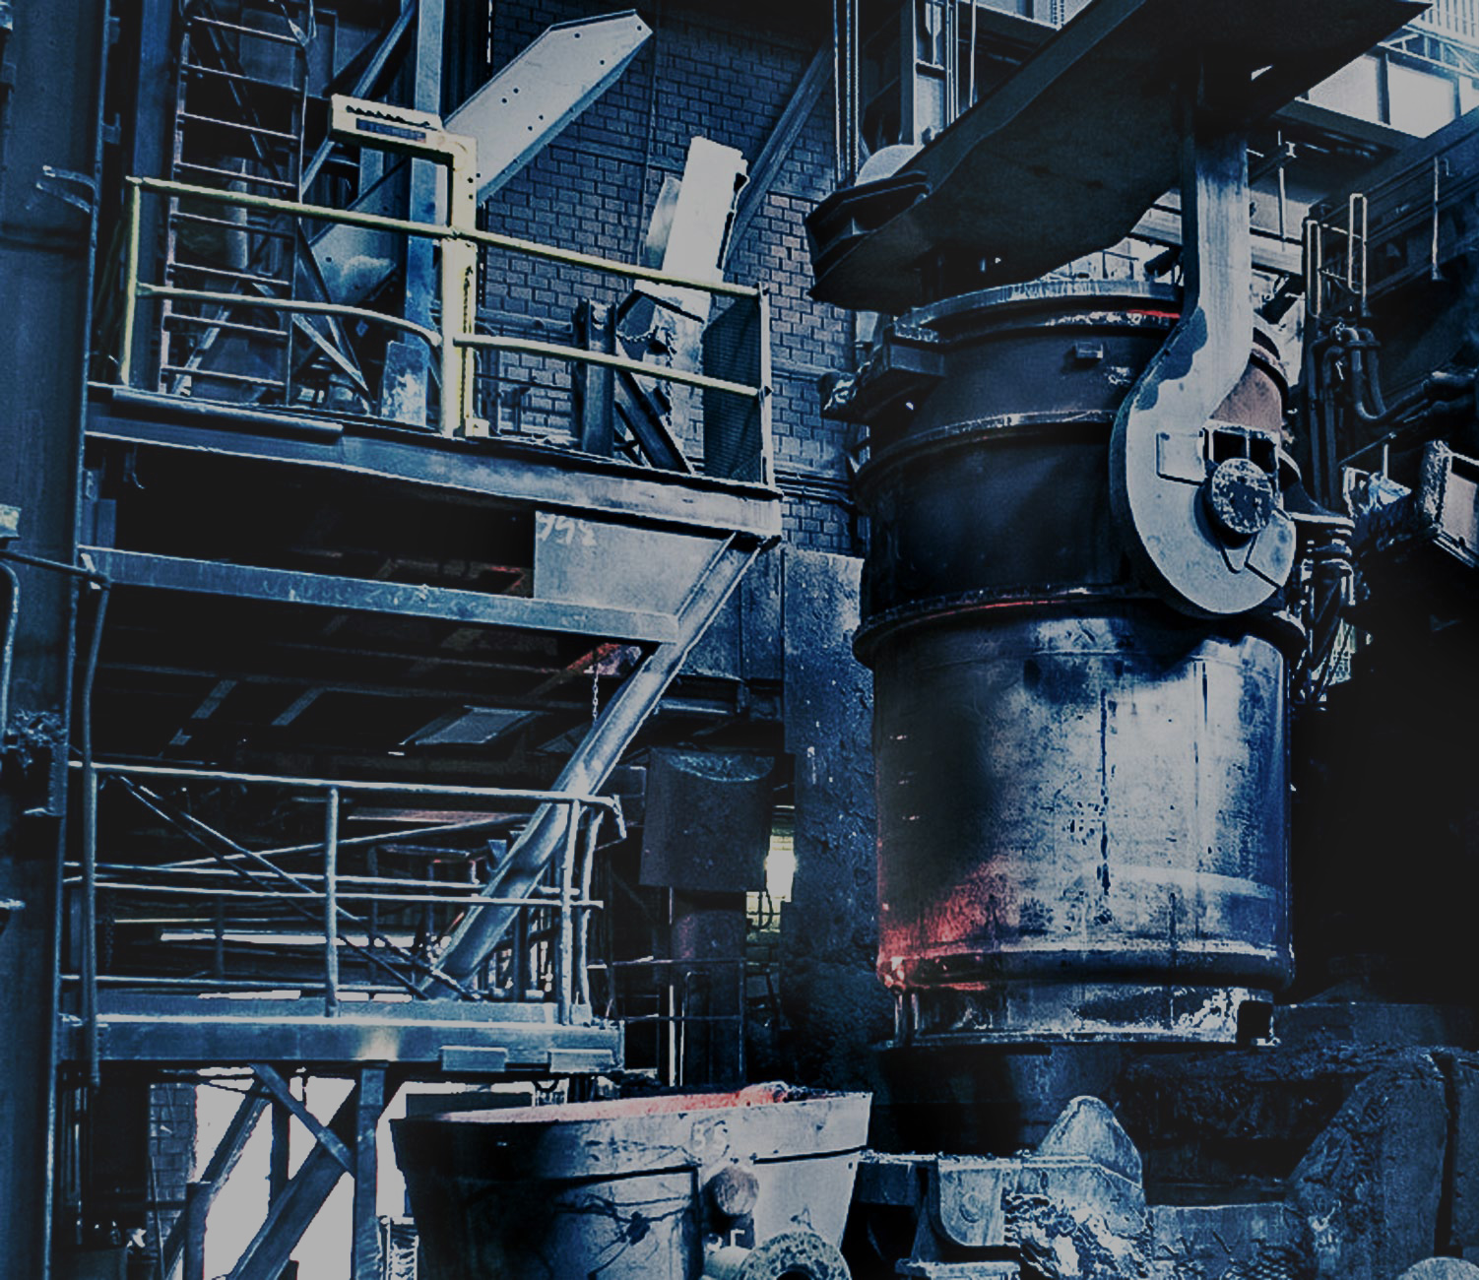
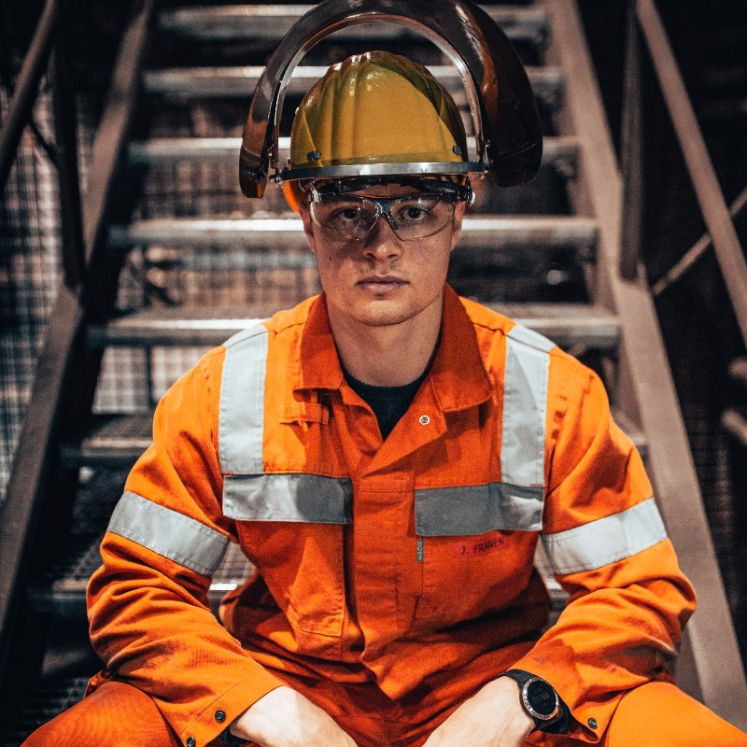
Testimonial
Digitalization | Industrial Software
Level 2 Software for Stainless Steelmaking
In order to achieve the planned decarbonization of the industry, the CO₂ balance of steel production plays an essential role. With the help of qontrol, we can map our production process completely digitally, and optimize the CO₂ balance sustainably on the basis of the integrated metallurgical models.
Julian Franek
Deputy Production Manager Melt Shop

Slide 30
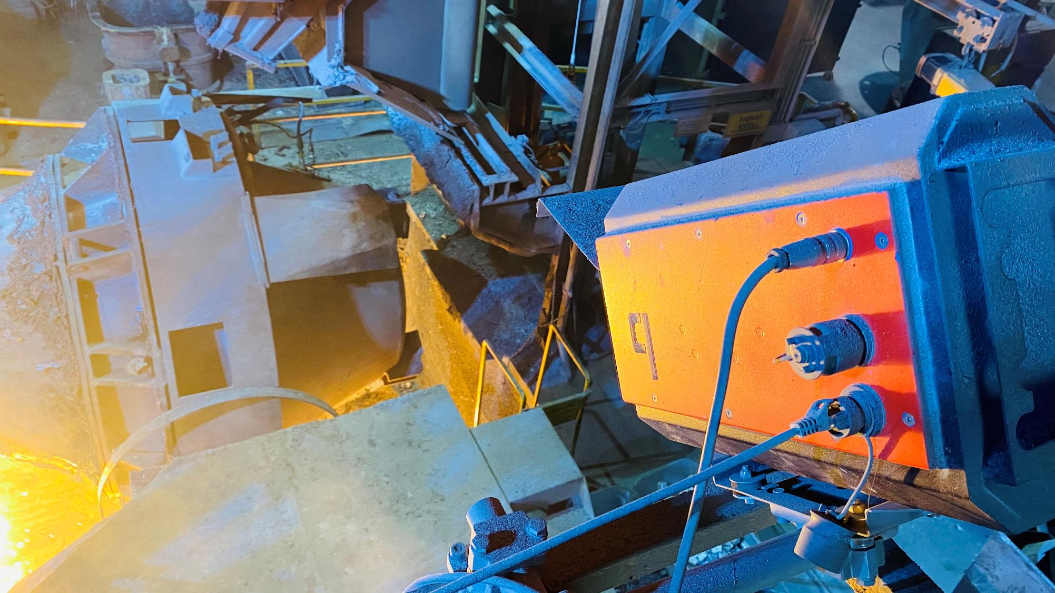

Hardware
Intelligent Cameras
A holistic solution for demanding conditions.

Slide 31
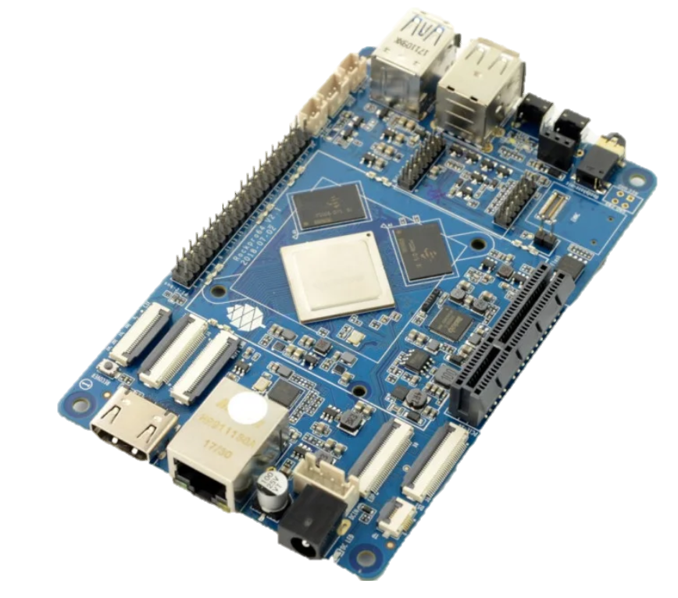
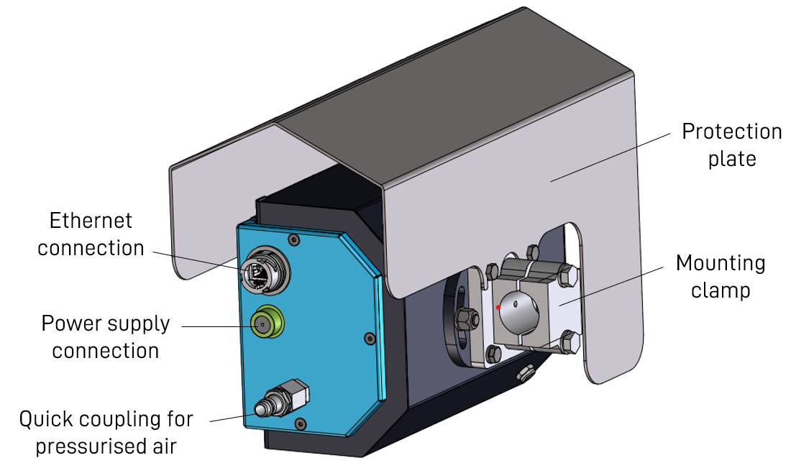
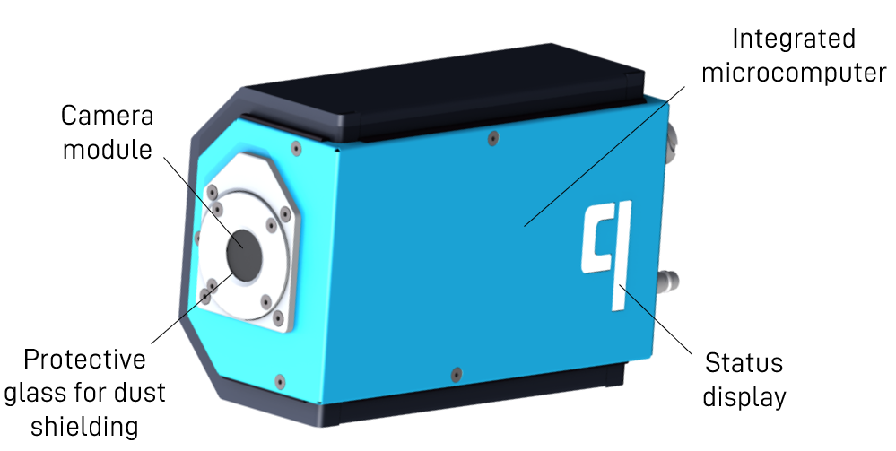
Hardware
Intelligent Cameras
A robust and complete camera system with computer vision (AI) on board (embedded technology).

Slide 32
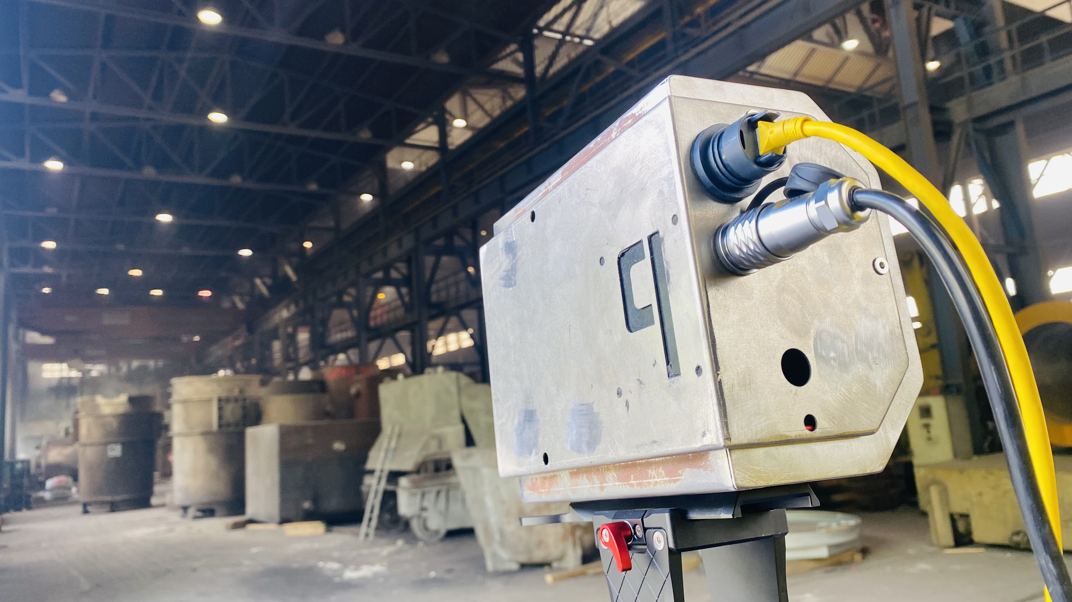
Hardware
Intelligent Cameras – Application
Together with our ladle management software, we can identify, track and manage all ladles in a steel plant to optimize
ladle lifetime,
maintenance,
logistics and
operator safety!
Our tests under steel mill conditions show: Even over distances of more than 50 m, our camera identifies the ladle.

Slide 33
03
equipment and devices

Slide 34

Equipment and Devices
Automatic coupling solutions
no manual work required
The system is designed to increase operator safety compared to any manual coupling operation.
qoupler is a patented, efficient, reliable and maintenance-friendly automatic connection device for coupling different media or drives in harsh environments like the metals or mining industry.

Slide 35
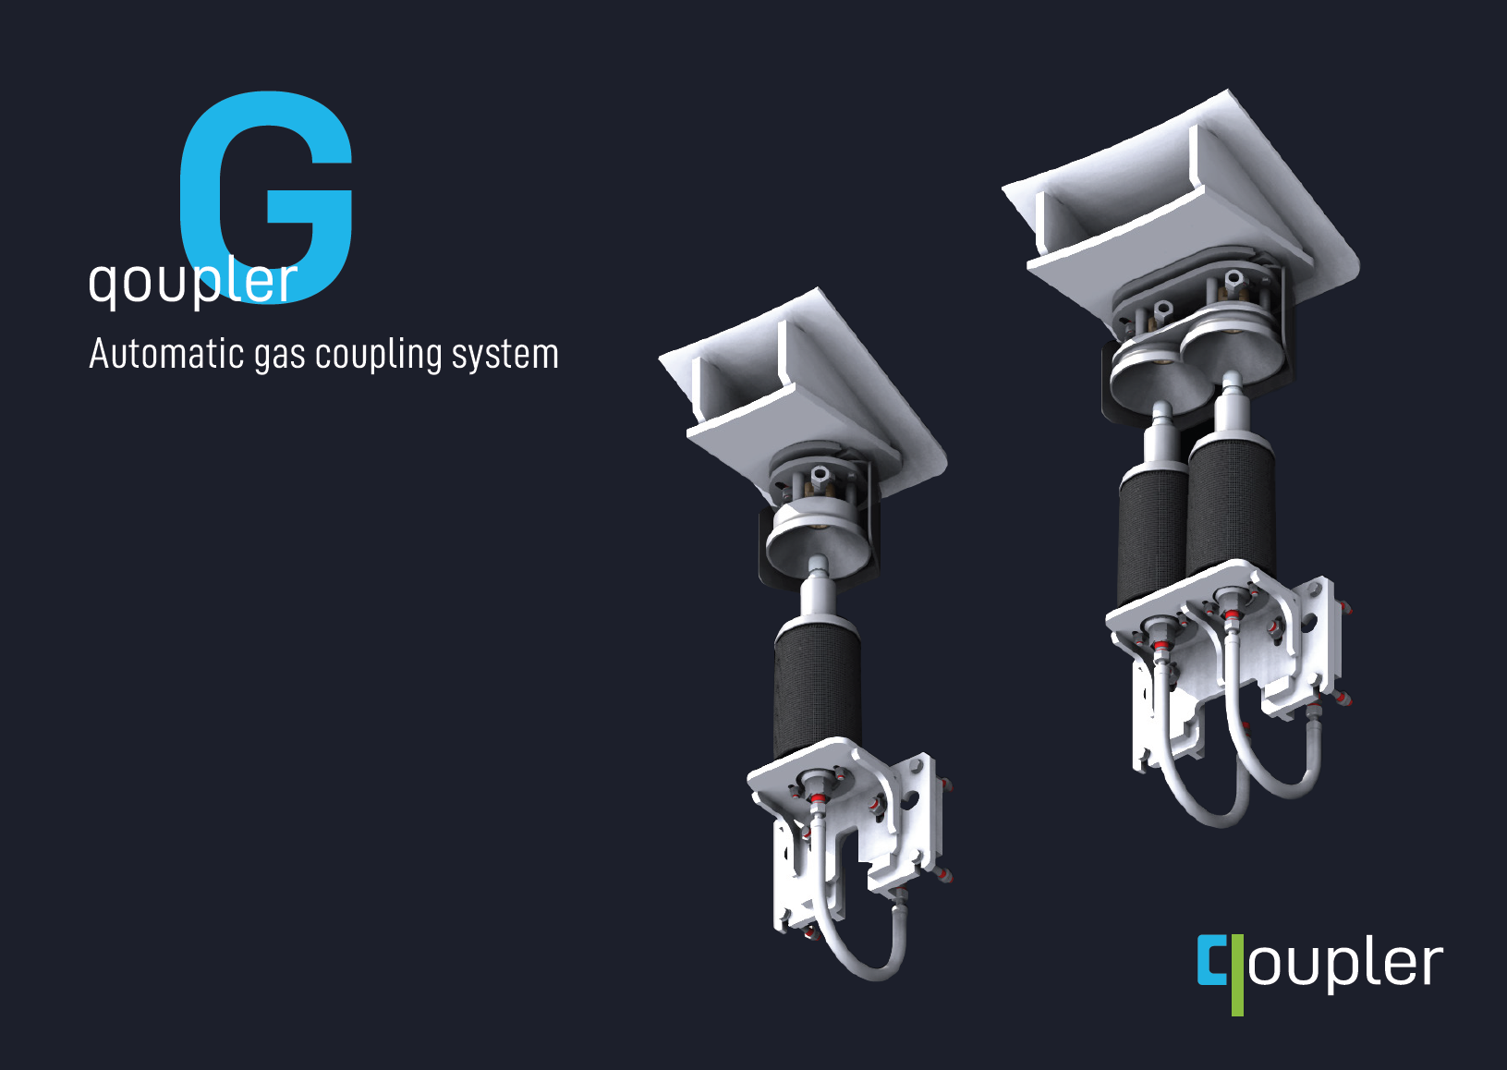
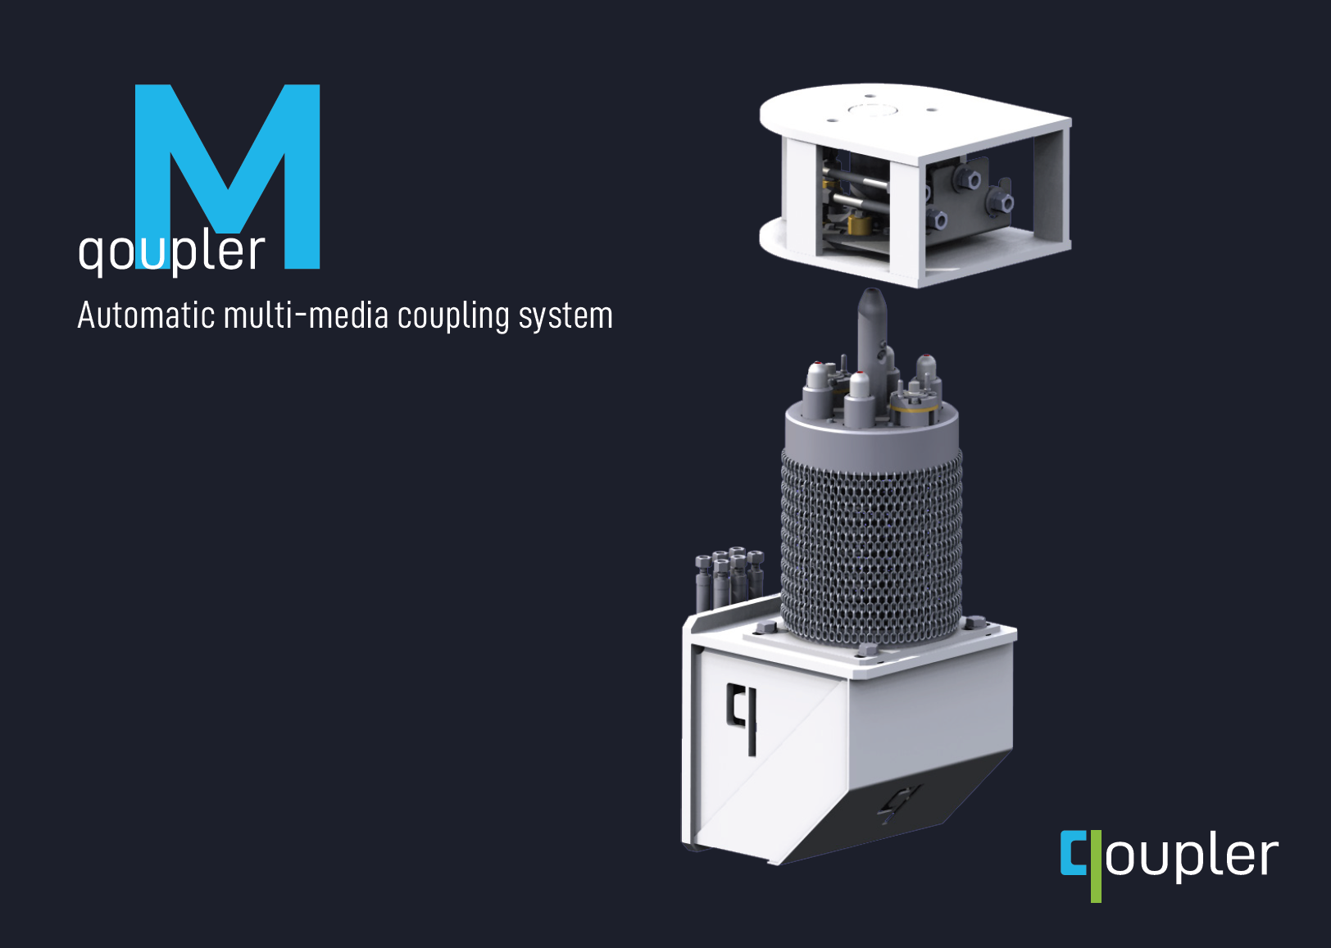
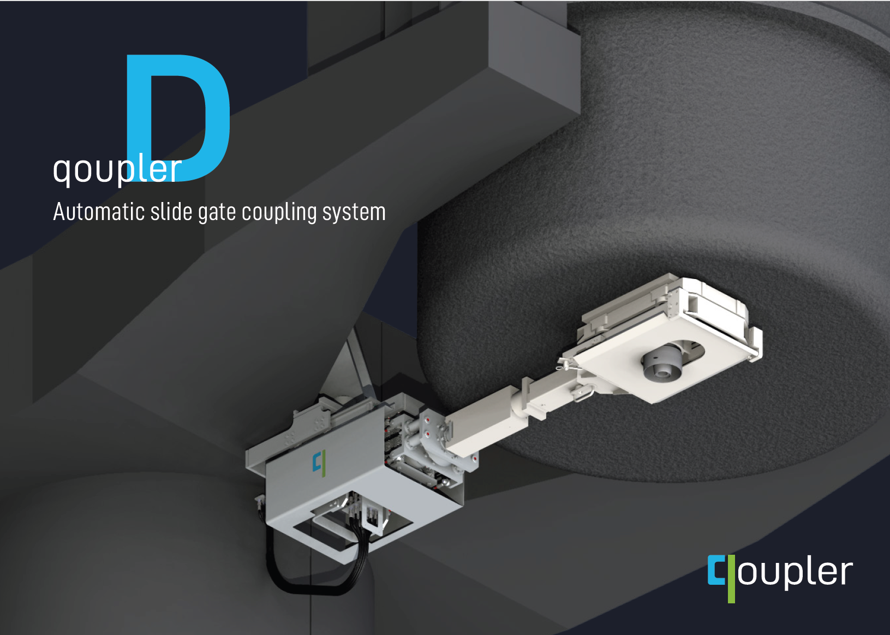
Equipment and Devices
Automatic coupling solutions

Slide 36
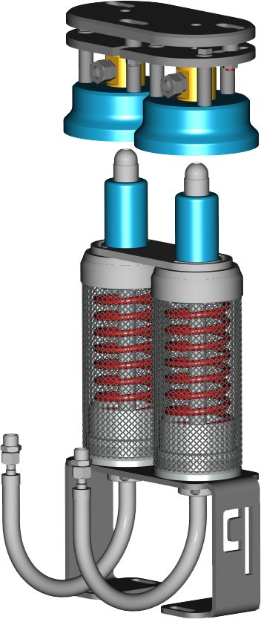
Equipment and Devices
Automatic coupling solutions
Countless installation possibilities:
Ingot Casting
lf
Vd / vod Tank
TAPPING POSITION
Continuous Casting

Slide 37
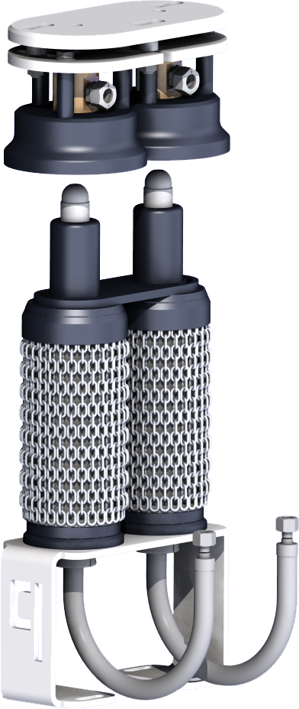
Equipment and Devices
Customized Mounting Bracket
Automatic Gas coupler – qoupler G
Female Section
on Ladle
Model G is a gas coupling system. It is the only solution that covers all ladle sizes and gas flow requirements with a single coupling for up to 3 separate gas feeding lines.
Connecting Sockets
Connecting Pins
System Highlights
Used to harshest environments, dust proof and temperature resistant.
Automatically actuated by placing the ladle on the ladle station.
Supply of gas starts immediately when the coupling halves meet.
No interlocking mechanism to fulfil all safety regulations.
Proven application with high flexibility in all directions.
Full metal on metal sealing mechanism.
Easy maintenance and minimum wear.
Highest operator safety.
Male Section
ON STATION
Gas Feeding Line

Slide 38




Equipment and Devices
Female (Moving Coupling Section)
Supply Lines
Heavy Duty Multiline Coupler – qoupler M
Connecting Sockets
Model M is the multi-coupling device. It automatically couples different media like gas, liquids, hydraulics or electrical currents with one multi-coupling connection.
Centering Pin
patented
Connecting Pins
System Highlights
Allows different media such as gas, liquids, hydraulics or electrical currents to be coupled simultaneously and automatically.
Immediate delivery of various media without the need for personnel to connect hoses or cables from the supply source.
High flexibility in all directions to compensate for misalignment between the coupling partners.
Used to harshest environments, dust-proof and temperature resistant.
Multi-function and multi-media coupling in a single coupling solution for up to 7 separate supply lines.
Patented solution for highest operator safety.
Connection Fittings
Supply Lines (Piping and Cabling)
Mounting Bracket
Male (Fixed Coupling) Section

Slide 39

Equipment and Devices
Slide Gate Coupler – qoupler D
It is designed to get the operator in the steel plant completely away from the ladle by making the connection to the ladle slide gate fully automatically with an external cylinder.
patented
System Highlights
Automatic coupling of hydraulic slide gate control (fixed on turret/car) to ladle slide gate mechanism (fixed on ladle).
Coupling actuated via pneumatic cylinder and locked via hydraulic locking device.
Supply of all required media, gas and electrics for ladle slide gate actuation and slag detection system for ladle slide gate.
Spring loaded system offers highest flexibility.
High flexibility in all directions to compensate for misalignment between the coupling partners.
For harshest environments, dust-proof and temperature resistant.
Patented solution for highest operator safety.
Very low maintenance and wear.

Slide 40


Equipment and Devices
References
Since 1997, qoncept staff has equipped:

Slide 41
04
consulting and studies

Slide 42









Consulting and Studies
Metallurgical Process Optimization & Feasibility Studies
Technological Consulting Services for Ingot Casting
Evaluation of Potential Steel Plant Improvements
Improving the Meltshop’s Productivity
Solidification Analysis for Continuous Casting
Evaluation of Potential Optimizations for Ingot Casting
Optimization of the Ingot Casting Quality
Evaluation of Savings Potential in Ladle Management
Conceptual Mechanical Engineering Study
Comparative Metallurgical Studies of Raw Material Use in EAF and IF
Technological Basic Data and Tender Evaluation Support of new CCM
Evaluation of the Concept of a Newly Planned Steel Plant

Slide 43







Consulting and Studies
Requirement & Software Engineering
Requirements analysis and conceptual software design for tracking the product life cycle (Böhler EdelstahlGmbH)
Requirement engineering for the digitalization of melting and casting operations (voestalpine Gießerei Traisen and Linz)
Development of a software enterprise architecture (Böhler Edelstahl GmbH)
Creation of a roadmap for the digitalization of a production facility (M.A.L. Anlagenbau GmbH)
Requirements analysis and design of a solution for the optimization of ferroalloy production (Treibacher AG)
Requirement engineering for the digitalization of a foundry (Irle Rolls GmbH)
Requirement engineering for the digitalization of a foundry (Pleissner Guss Gießerei GmbH & Co KG)
Several software requirements projects for steel production (steelworks in Germany, USA and Chile)

Slide 44
challenge us
For inquiries, reach out to:
Dr. Stefan Griesser
qoncept technology GmbH
Waasenstraße 16, 8700 Leoben, Austria
Head of Sales and Business Development
stefan.griesser@qoncept.at
office@qoncept.at
www.qoncept.at
+43 3842 30 300

